Slide 1


Slide 2


Lecture 02: Sequential Decisions under Uncertainty - Markov Decision Processes
Scan me:
Anonymous Questions (during or after the lecture)
Quizzes
vevox.app
161-834-334
The Lecture will be recorded
2

Slide 3
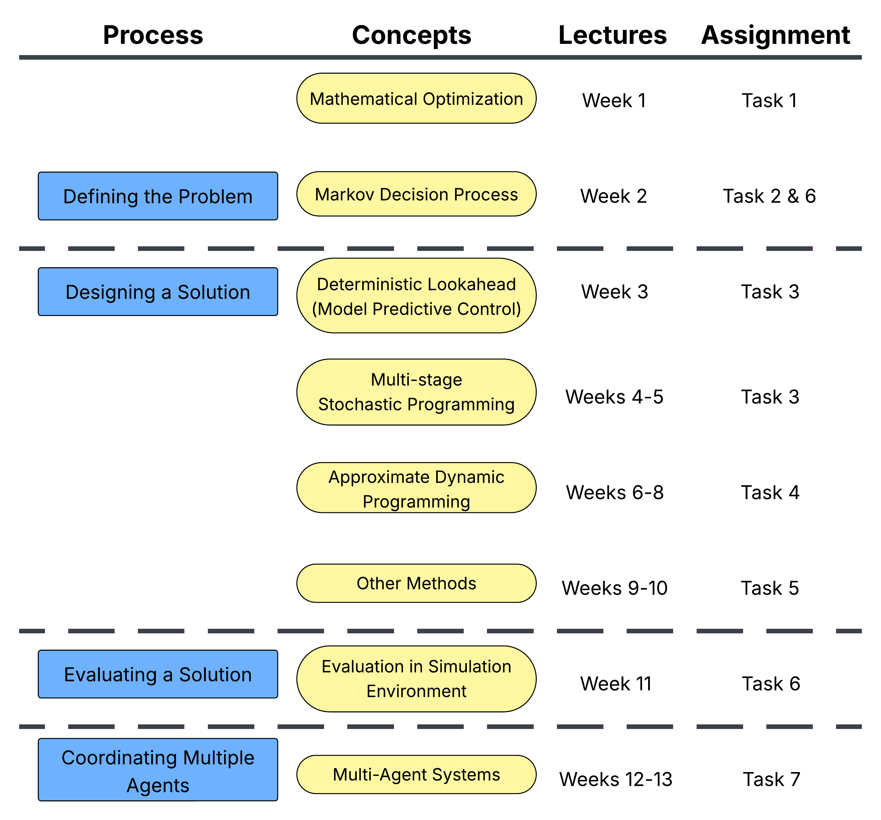
Course Plan
without
Uncertainty
3
Notes:
3

Slide 4
Agenda for today
Small example
Defining a problem of Sequential Decisions under Uncertainty
Student’s problem as a Sequential Decisions problem
Applying what we learned on the Lead Example
How to code an Evaluation Framework
Quiz with 1.5 bonus points for the top 3.

Slide 5
The process of designing
“Decision-making” frameworks
Markov Decision Process
Define
Design
Evaluate
5
Notes:
5

Slide 6
The process of designing
“Decision-making” frameworks
Markov Decision Process
Define
Design
Evaluate
6
Notes:
6

Slide 7

The Bike-to-University problem
Objective: Get to DTU as fast as possible but without getting too tired
$d_{t}$: distance from university
$F_{t}$: fatigue
7

Slide 8
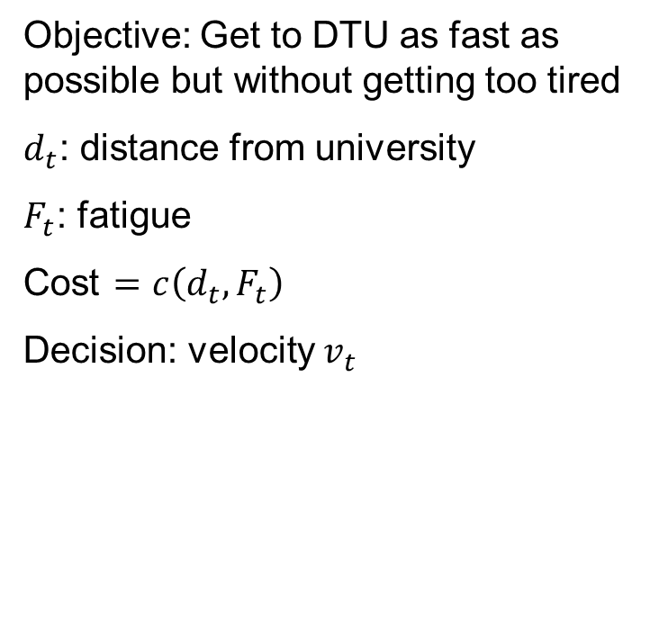
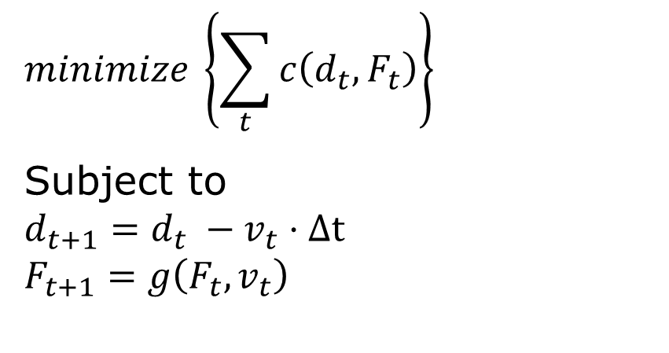
The Bike-to-University problem
Objective: Get to DTU as fast as possible but without getting too tired
$d_{t}$: distance from university
$F_{t}$: fatigue
Cost $=c\left(d_{t}, F_{t}\right)$
Decision: velocity $v_{t}$
$$minimize \left\{\sum_{t}{c\left(d_{t}, F_{t}\right)}\right\}$$
Subject to
$$d_{t+1}=d_{t} −v_{t}⋅Δt$$
$$F_{t+1}=g\left(F_{t}, v_{t}\right)$$
8

Slide 9
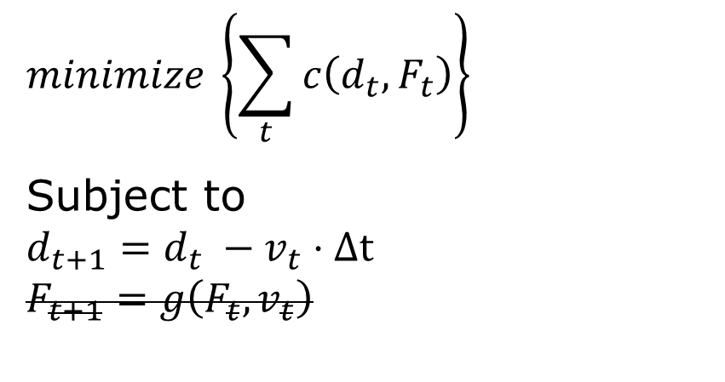
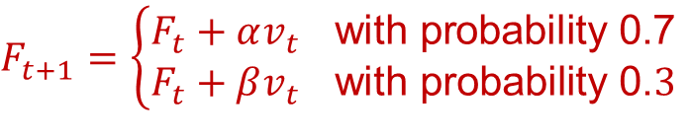
Stochastic Dynamics
Objective: Get to DTU as fast as possible but without getting too tired
$d_{t}$: distance from university
$F_{t}$: fatigue
Cost $=c\left(d_{t}, F_{t}\right)$
Decision: velocity $v_{t}$
$$minimize \left\{\sum_{t}{c\left(d_{t}, F_{t}\right)}\right\}$$
Subject to
$$d_{t+1}=d_{t} −v_{t}⋅Δt$$
$$F_{t+1}=g\left(F_{t}, v_{t}\right)$$
$F_{t+1}=\left\{\begin{aligned}F_{t}+αv_{t} \text{with} \text{probability}\text{ 0.7} \\ F_{t}+βv_{t} \text{with} \text{probability}\text{ 0.}3\end{aligned}\right.$
9

Slide 10
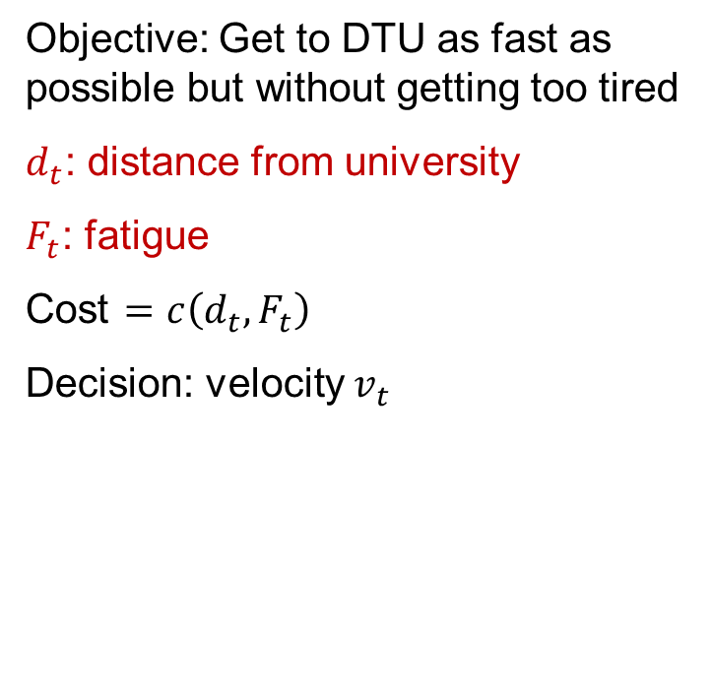
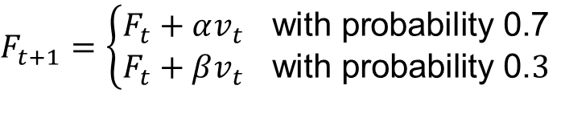
State Variables
Objective: Get to DTU as fast as possible but without getting too tired
$d_{t}$: distance from university
$F_{t}$: fatigue
Cost $=c\left(d_{t}, F_{t}\right)$
Decision: velocity $v_{t}$
$$minimize \left\{\sum_{t}{c\left(d_{t}, F_{t}\right)}\right\}$$
Subject to
$$d_{t+1}=d_{t} −v_{t}⋅Δt$$
$$F_{t+1}=g\left(F_{t}, v_{t}\right)$$
$F_{t+1}=\left\{\begin{aligned}F_{t}+αv_{t} \text{with} \text{probability}\text{ 0.7} \\ F_{t}+βv_{t} \text{with} \text{probability}\text{ 0.}3\end{aligned}\right.$
10

Slide 11
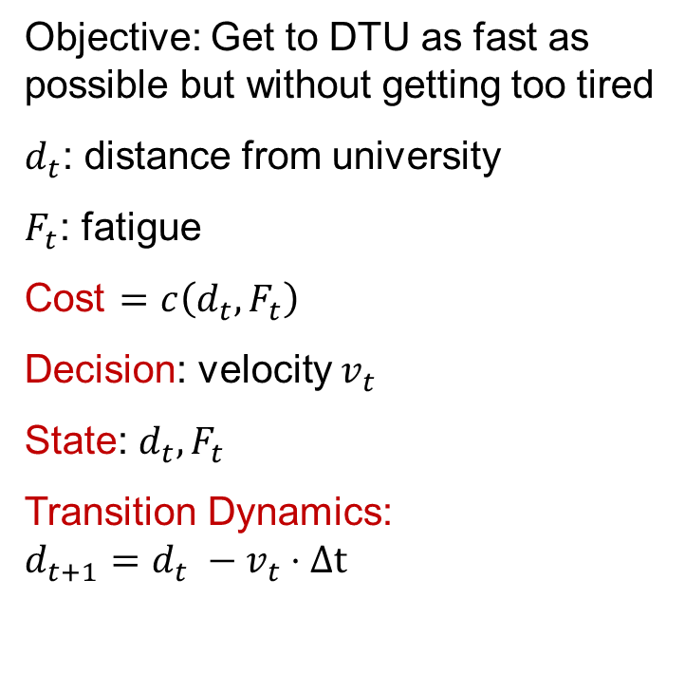
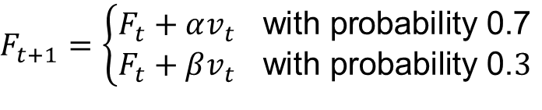
The Bike-to-University problem as a Markov Decision Process (MDP)
Objective: Get to DTU as fast as possible but without getting too tired
$d_{t}$: distance from university
$F_{t}$: fatigue
Cost $=c\left(d_{t}, F_{t}\right)$
Decision: velocity $v_{t}$
State: $d_{t}, F_{t}$
Transition Dynamics:
$$d_{t+1}=d_{t} −v_{t}⋅Δt$$
$F_{t+1}=\left\{\begin{aligned}F_{t}+αv_{t} \text{with} \text{probability}\text{ 0.7} \\ F_{t}+βv_{t} \text{with} \text{probability}\text{ 0.}3\end{aligned}\right.$
11

Slide 12
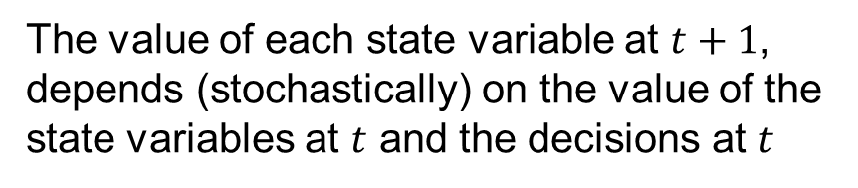
The Bike-to-University problem as a Markov Decision Process (MDP)
Objective: Get to DTU as fast as possible but without getting too tired
$d_{t}$: distance from university
$F_{t}$: fatigue
Cost $=c\left(d_{t}, F_{t}\right)$
Decision: velocity $v_{t}$
State: $d_{t}, F_{t}$
Transition Dynamics:
$$d_{t+1}=d_{t} −v_{t}⋅Δt$$
“The Markov property”
The value of each state variable at $t+1$, depends (stochastically) on the value of the state variables at $t$ and the decisions at $t$
$F_{t+1}=\left\{\begin{aligned}F_{t}+αv_{t} \text{with} \text{probability}\text{ 0.7} \\ F_{t}+βv_{t} \text{with} \text{probability}\text{ 0.}3\end{aligned}\right.$
12

Slide 13
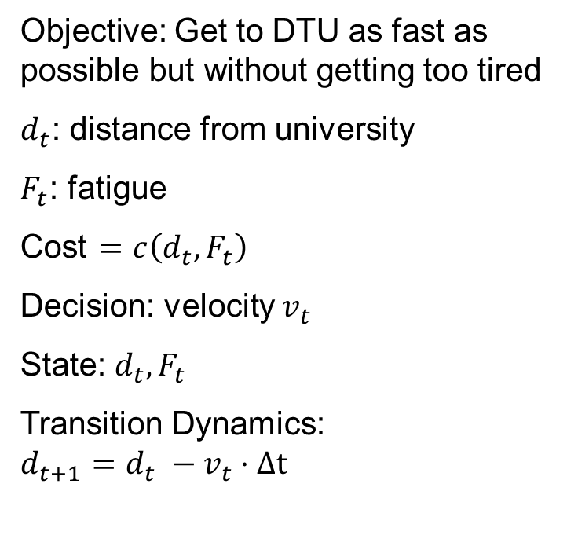
Solution Concept
Objective: Get to DTU as fast as possible but without getting too tired
$d_{t}$: distance from university
$F_{t}$: fatigue
Cost $=c\left(d_{t}, F_{t}\right)$
Decision: velocity $v_{t}$
State: $d_{t}, F_{t}$
Transition Dynamics:
$$d_{t+1}=d_{t} −v_{t}⋅Δt$$
Solution Concept: …?
$F_{t+1}=\left\{\begin{aligned}F_{t}+αv_{t} \text{with} \text{probability}\text{ 0.7} \\ F_{t}+βv_{t} \text{with} \text{probability}\text{ 0.}3\end{aligned}\right.$
13

Slide 14

Policy
Objective: Get to DTU as fast as possible but without getting too tired
$d_{t}$: distance from university
$F_{t}$: fatigue
Cost $=c\left(d_{t}, F_{t}\right)$
Decision: velocity $v_{t}$
State: $d_{t}, F_{t}$
Transition Dynamics:
$$d_{t+1}=d_{t} −v_{t}⋅Δt$$
Solution Concept: A decision-making policy
$$v_{t}=π\left(d_{t}, F_{t}\right)$$
State Variables
$F_{t+1}=\left\{\begin{aligned}F_{t}+αv_{t} \text{with} \text{probability}\text{ 0.7} \\ F_{t}+βv_{t} \text{with} \text{probability}\text{ 0.}3\end{aligned}\right.$
14

Slide 15

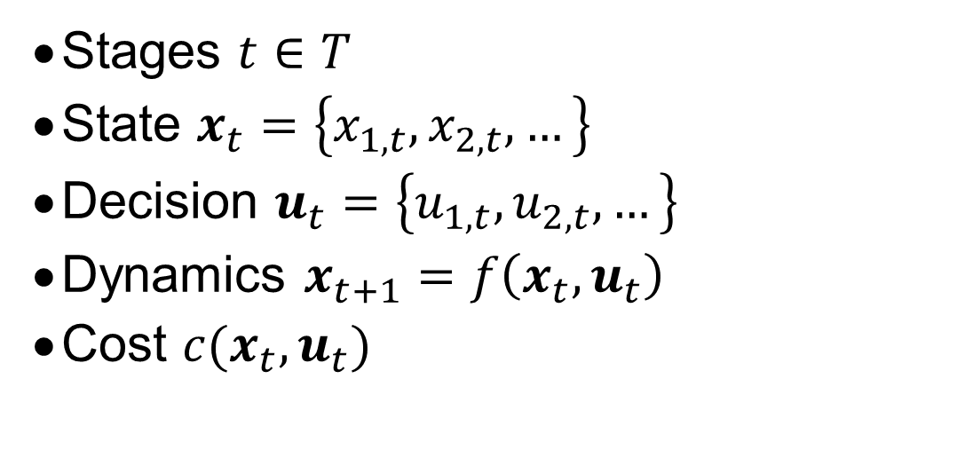
Markov Decision Process (MDP)
Stages $t∈T$
State $x_{t}=\left\{x_{1, t}, x_{2,t}, …\right\}$
Decision $u_{t}=\left\{u_{1, t}, u_{2,t}, …\right\}$
Dynamics $x_{t+1}=f\left(x_{t}, u_{t}\right)$
Cost $c(x_{t}, u_{t})$
The State variables $x_{t}$ enclose the relevant information to model the system’s behavior from stage $t$ onwards.

Slide 16
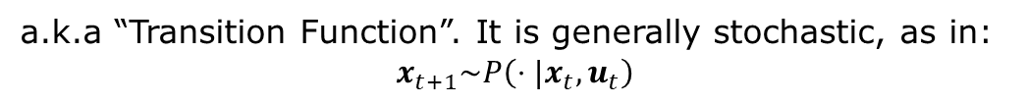
Markov Decision Process (MDP)
Stages $t∈T$
State $x_{t}=\left\{x_{1, t}, x_{2,t}, …\right\}$
Decision $u_{t}=\left\{u_{1, t}, u_{2,t}, …\right\}$
Dynamics $x_{t+1}=f\left(x_{t}, u_{t}\right)$
Cost $c(x_{t}, u_{t})$
a.k.a. “actions” or “controls” or “manipulated variables”
a.k.a “Transition Function”. It is generally stochastic, as in:
$$x_{t+1}\sim P\left(⋅|x_{t}, u_{t}\right)$$
a.k.a. “Reward” function
The State variables $x_{t}$ enclose the relevant information to model the system’s behavior from stage $t$ onwards.

Slide 17

Markov Decision Process (MDP)
Stages $t∈T$
State $x_{t}=\left\{x_{1, t}, x_{2,t}, …\right\}$
Decision $u_{t}=\left\{u_{1, t}, u_{2,t}, …\right\}$
Dynamics $x_{t+1}=f\left(x_{t}, u_{t}\right)$
Cost $c(x_{t}, u_{t})$
The State variables $x_{t}$ enclose the relevant information to model the system’s behavior from stage $t$ onwards.
Are all sequential decision frameworks Markovian?

Slide 18
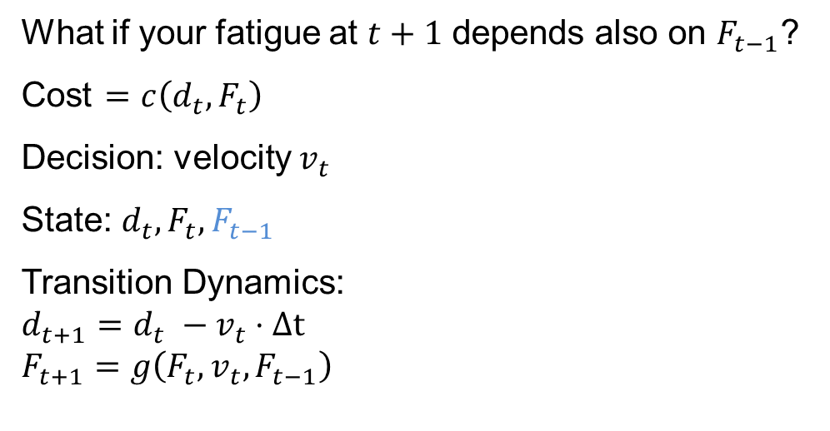
Markov Decision Process (MDP)
Stages $t∈T$
State $x_{t}=\left\{x_{1, t}, x_{2,t}, …\right\}$
Decision $u_{t}=\left\{u_{1, t}, u_{2,t}, …\right\}$
Dynamics $x_{t+1}=f\left(x_{t}, u_{t}\right)$
Cost $c(x_{t}, u_{t})$
What if your fatigue at $t+1$ depends also on $F_{t−1}$?
Cost $=c\left(d_{t}, F_{t}\right)$
Decision: velocity $v_{t}$
State: $d_{t}, F_{t}, F_{t−1}$
Transition Dynamics:
$$d_{t+1}=d_{t} −v_{t}⋅Δt$$
$$F_{t+1}=g\left(F_{t}, v_{t}, F_{t−1}\right)$$
The State variables $x_{t}$ enclose the relevant information to model the system’s behavior from stage $t$ onwards.
Are all sequential decision frameworks Markovian?

Slide 19
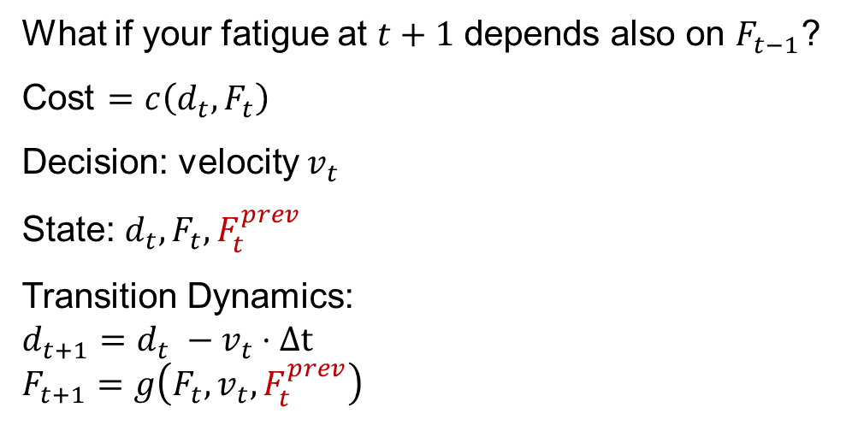
Markov Decision Process (MDP)
Stages $t∈T$
State $x_{t}=\left\{x_{1, t}, x_{2,t}, …\right\}$
Decision $u_{t}=\left\{u_{1, t}, u_{2,t}, …\right\}$
Dynamics $x_{t+1}=f\left(x_{t}, u_{t}\right)$
Cost $c(x_{t}, u_{t})$
What if your fatigue at $t+1$ depends also on $F_{t−1}$?
Cost $=c\left(d_{t}, F_{t}\right)$
Decision: velocity $v_{t}$
State: $d_{t}, F_{t}, F_{t}^{prev}$
Transition Dynamics:
$$d_{t+1}=d_{t} −v_{t}⋅Δt$$
$$F_{t+1}=g\left(F_{t}, v_{t},F_{t}^{prev}\right)$$
The State variables $x_{t}$ enclose the relevant information to model the system’s behavior from stage $t$ onwards.
No, but they can be made Markovian with State Augmentation
Are all sequential decision frameworks Markovian?

Slide 20
Markov Decision Process (MDP)
Stages $t∈T$
State $x_{t}=\left\{x_{1, t}, x_{2,t}, …\right\}$
Decision $u_{t}=\left\{u_{1, t}, u_{2,t}, …\right\}$
Dynamics $x_{t+1}=f\left(x_{t}, u_{t}\right)$
Cost $c(x_{t}, u_{t})$
The State variables $x_{t}$ enclose the relevant information to model the system’s behavior from stage $t$ onwards.
Are all sequential decision frameworks Markovian?
Can you think of examples?
If the Dynamics of some state: $w_{t+1}=g\left(x_{t}, u_{t}\right)$ do not depend on the decisions
we will call this an “exogenous state variable”

Slide 21
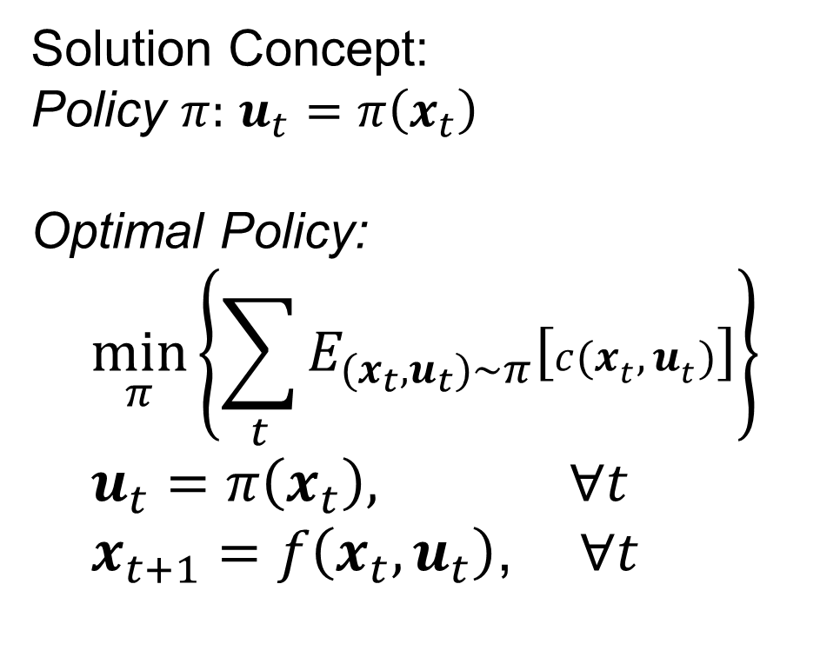
Markov Decision Process (MDP)
Stages $t∈T$
State $x_{t}=\left\{x_{1, t}, x_{2,t}, …\right\}$
Decision $u_{t}=\left\{u_{1, t}, u_{2,t}, …\right\}$
Dynamics $x_{t+1}=f\left(x_{t}, u_{t}\right)$
Cost $c(x_{t}, u_{t})$
Solution Concept:
Policy $π:$ $u_{t}=π\left(x_{t}\right)$
Optimal Policy:
$$\min_{π}\left\{\sum_{t}{E_{(x_{t}, u_{t})\sim π}\left[c(x_{t}, u_{t})\right]}\right\} \\ u_{t}=π\left(x_{t}\right), ∀t \\ x_{t+1}=f\left(x_{t}, u_{t}\right)\text{, } ∀t$$
The State variables $x_{t}$ enclose the relevant information to model the system’s behavior from stage $t$ onwards.
Are all sequential decision frameworks Markovian?
If the Dynamics of some state: $w_{t+1}=g\left(x_{t}, u_{t}\right)$ do not depend on the decisions,
we will call this an “exogenous state variable”

Slide 22
Markov Decision Process (MDP)
Stages $t∈T$
State $x_{t}=\left\{x_{1, t}, x_{2,t}, …\right\}$
Decision $u_{t}=\left\{u_{1, t}, u_{2,t}, …\right\}$
Dynamics $x_{t+1}=f\left(x_{t}, u_{t}\right)$
Cost $c(x_{t}, u_{t})$
Solution Concept:
Policy $π:$ $u_{t}=π\left(x_{t}\right)$
Optimal Policy:
$$\min_{π}\left\{\sum_{t}{E_{(x_{t}, u_{t})\sim π}\left[c(x_{t}, u_{t})\right]}\right\} \\ u_{t}=π\left(x_{t}\right), ∀t \\ x_{t+1}=f\left(x_{t}, u_{t}\right)\text{, } ∀t$$
a.k.a. Control Law or Agent
The State variables $x_{t}$ enclose the relevant information to model the system’s behavior from stage $t$ onwards.
Are all sequential decision frameworks Markovian?
If the Dynamics of some state: $w_{t+1}=g\left(x_{t}, u_{t}\right)$ do not depend on the decisions,
we will call this an “exogenous state variable”

Slide 23
Defining an MDP out of verbal explanations
Markov Decision Process
Define
Design
Evaluate
How do we extract this information from the stakeholder?
23
Notes:
23

Slide 24
Defining an MDP out of verbal explanations
Markov Decision Process
Define
Design
Evaluate
What is our performance metric?
What do we get to decide / control?
How often do we get/need to make a decision?
What are the sources of uncertainty/ What can be observed*?
How exactly are these connected?
24
Notes:
24

Slide 25
Defining an MDP out of verbal explanations
Markov Decision Process
Define
Design
Evaluate
Cost Function
What is our performance metric?
What do we get to decide / control?
How often do we get/need to make a decision?
What are the sources of uncertainty/ What can be observed*?
How exactly are these connected?
Actions
(+ constraints)
Time granularity
State Variables
Dynamics
(+constraints)
25
Notes:
25

Slide 26
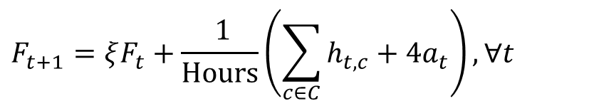
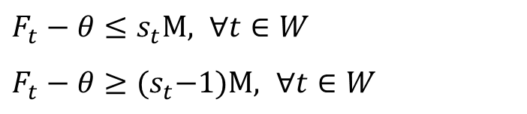
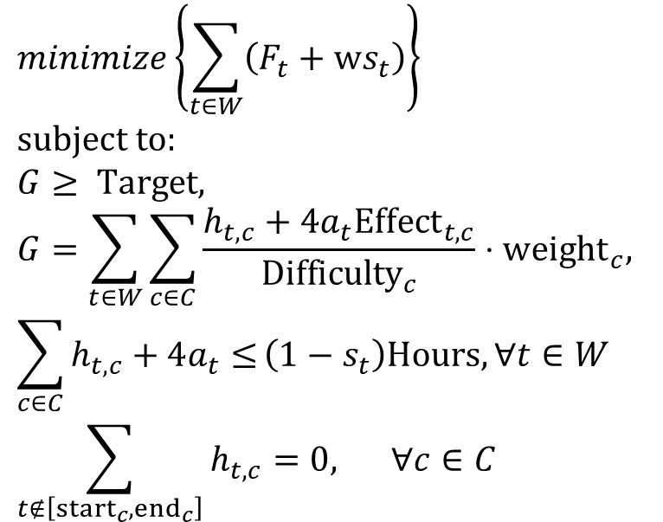
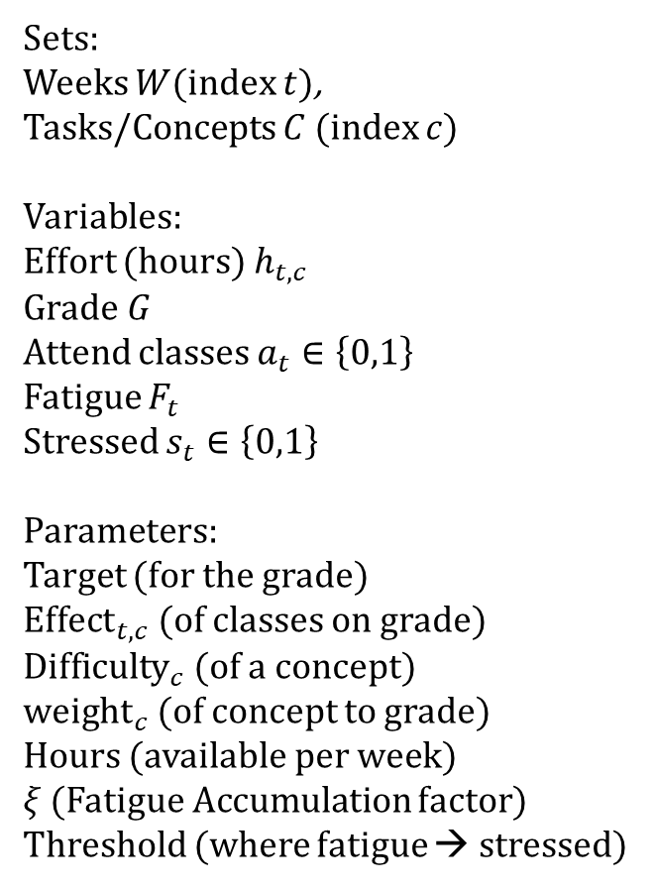
The student’s problem
Sets:
Weeks $W$(index $t$),
Tasks/Concepts $C$ (index $c$)
Variables:
Effort (hours) $h_{t,c}$
Grade $G$
Attend classes $a_{t}∈\left\{0,1\right\}$
Fatigue $F_{t}$
Stressed $s_{t}∈\left\{0,1\right\}$
Parameters:
Target (for the grade)
${Effect}_{t,c}$ (of classes on grade)
${Difficulty}_{c}$ (of a concept)
${weight}_{c}$ (of concept to grade)
Hours (available per week)
$ξ$ (Fatigue Accumulation factor)
Threshold (where fatigue → stressed)
$$minimize\left\{\sum_{t∈W}{\left(F_{t}+ws_{t}\right)}\right\} \\ subject to:$$
$$G≥ Target,$$
$$G=\sum_{t∈W}{\sum_{c∈C}{\frac{h_{t,c}+4a_{t}{Effect}_{t,c}}{{Difficulty}_{c}}}}⋅{weight}_{c}, \\ \sum_{c∈C}{h_{t,c}+4a_{t}≤}\left(1−s_{t}\right)Hours, ∀t∈W \\ \sum_{t∉\left[{start}_{c}, {end}_{c}\right]}{h_{t,c}=0, } ∀c∈C$$
$$F_{t+1}=ξF_{t}+\frac{ 1}{Hours}\left(\sum_{c∈C}{h_{t,c}+4a_{t}}\right), ∀t$$
Let’s simplify it so that we don’t carry too much luggage
$F_{1}=$ initial fatigue
$F_{t}−θ≤s_{t}M, ∀t∈W$
$F_{t}−θ≥{(s}_{t}−1)M, ∀t∈W$

Slide 27
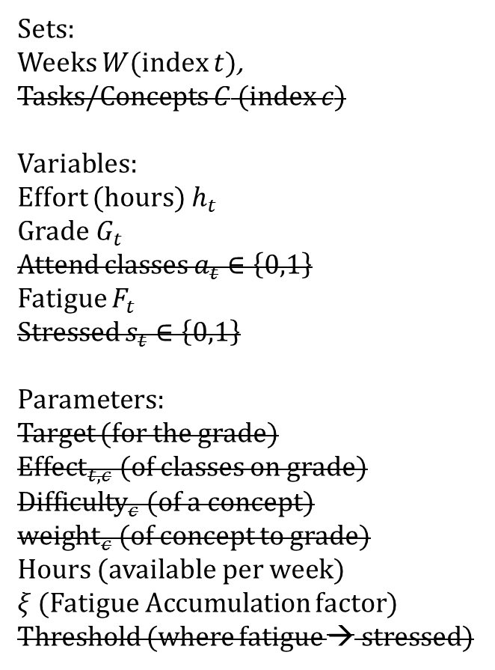
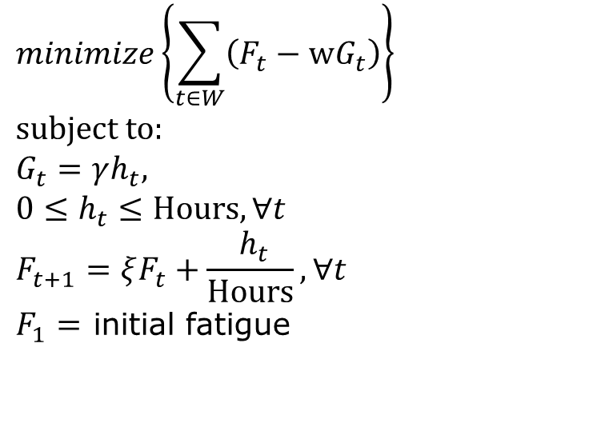
The student’s problem simplified
Sets:
Weeks $W$(index $t$),
Tasks/Concepts $C$ (index $c$)
Variables:
Effort (hours) $h_{t }$
Grade $G_{t}$
Attend classes $a_{t}∈\left\{0,1\right\}$
Fatigue $F_{t}$
Stressed $s_{t}∈\left\{0,1\right\}$
Parameters:
Target (for the grade)
${Effect}_{t,c}$ (of classes on grade)
${Difficulty}_{c}$ (of a concept)
${weight}_{c}$ (of concept to grade)
Hours (available per week)
$ξ$ (Fatigue Accumulation factor)
Threshold (where fatigue → stressed)
$$minimize\left\{\sum_{t∈W}{\left(F_{t}−wG_{t}\right)}\right\} \\ subject to:$$
$$G_{t}=γh_{t},$$
$$0≤h_{t}≤Hours, ∀t$$
$$F_{t+1}=ξF_{t}+\frac{ h_{t}}{Hours}, ∀t$$
$F_{1}=$ initial fatigue

Slide 28
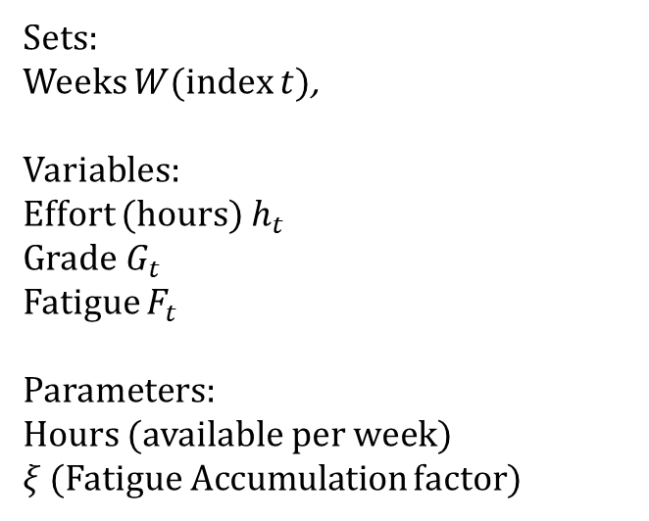
The student’s problem simplified
Sets:
Weeks $W$(index $t$),
Variables:
Effort (hours) $h_{t }$
Grade $G_{t}$
Fatigue $F_{t}$
Parameters:
Hours (available per week)
$ξ$ (Fatigue Accumulation factor)
$$minimize\left\{\sum_{t∈W}{\left(F_{t}−wG_{t}\right)}\right\} \\ subject to:$$
$$G_{t}=γh_{t},$$
$$0≤h_{t}≤Hours, ∀t$$
$$F_{t+1}=ξF_{t}+\frac{ h_{t}}{Hours}, ∀t$$
$F_{1}=$ initial fatigue

Slide 29
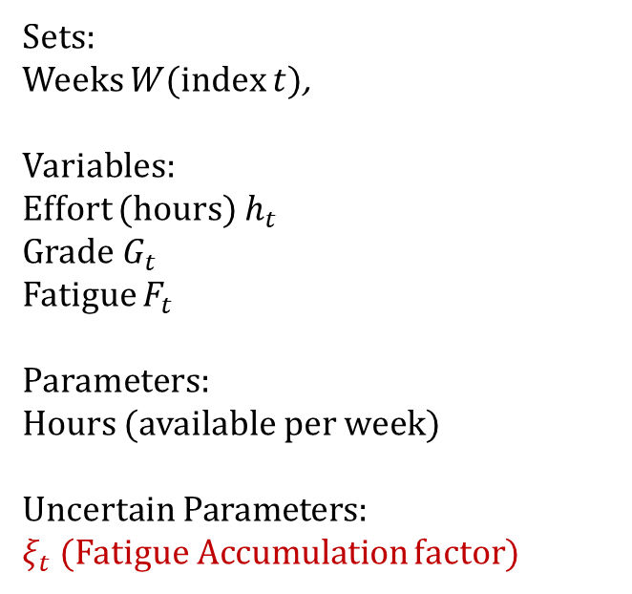
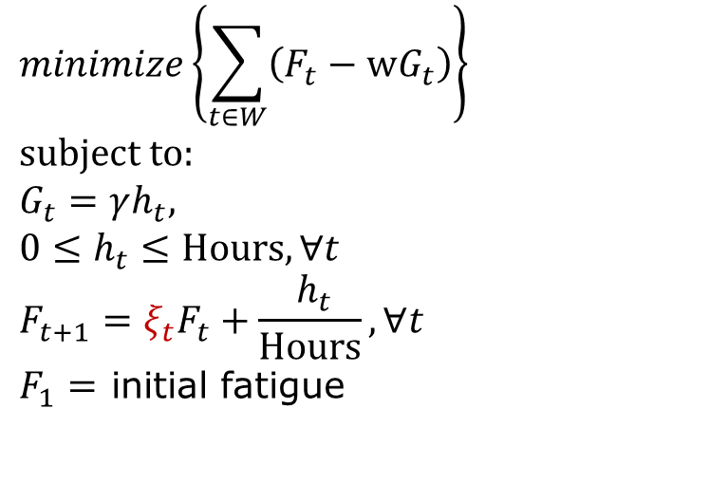
The student’s problem under uncertainty
Sets:
Weeks $W$(index $t$),
Variables:
Effort (hours) $h_{t }$
Grade $G_{t}$
Fatigue $F_{t}$
Parameters:
Hours (available per week)
Uncertain Parameters:
$ξ_{t}$ (Fatigue Accumulation factor)
$$minimize\left\{\sum_{t∈W}{\left(F_{t}−wG_{t}\right)}\right\} \\ subject to:$$
$$G_{t}=γh_{t},$$
$$0≤h_{t}≤Hours, ∀t$$
$$F_{t+1}=ξ_{t}F_{t}+\frac{ h_{t}}{Hours}, ∀t$$
$F_{1}=$ initial fatigue

Slide 30
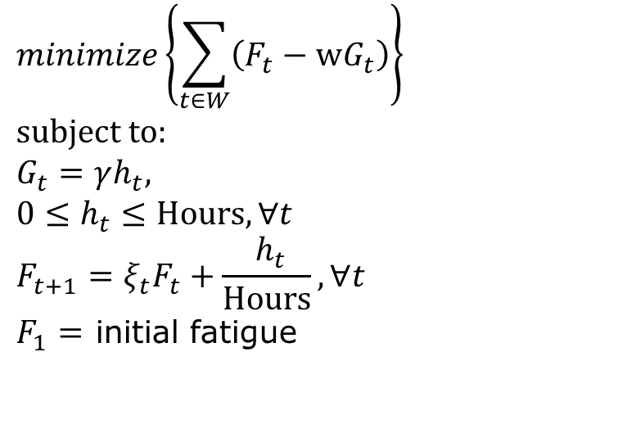
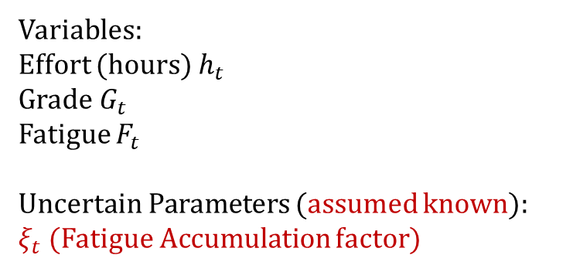
The student’s problem as a sequential decision problem
Deterministic Optimization Problem
Variables:
Effort (hours) $h_{t }$
Grade $G_{t}$
Fatigue $F_{t}$
Uncertain Parameters (assumed known):
$ξ_{t}$ (Fatigue Accumulation factor)
$$minimize\left\{\sum_{t∈W}{\left(F_{t}−wG_{t}\right)}\right\} \\ subject to:$$
$$G_{t}=γh_{t},$$
$$0≤h_{t}≤Hours, ∀t$$
$$F_{t+1}=ξ_{t}F_{t}+\frac{ h_{t}}{Hours}, ∀t$$
$F_{1}=$ initial fatigue

Slide 31

The student’s problem as a sequential decision problem
Deterministic Optimization Problem
Sequential Decision Problem
Variables:
Effort (hours) $h_{t }$
Grade $G_{t}$
Fatigue $F_{t}$
Uncertain Parameters (assumed known):
$ξ_{t}$ (Fatigue Accumulation factor)
Cost:
Actions:
States:
Transition
Dynamics:
$$minimize\left\{\sum_{t∈W}{\left(F_{t}−wG_{t}\right)}\right\} \\ subject to:$$
$$G_{t}=γh_{t},$$
$$0≤h_{t}≤Hours, ∀t$$
$$F_{t+1}=ξ_{t}F_{t}+\frac{ h_{t}}{Hours}, ∀t$$
$F_{1}=$ initial fatigue
$$x_{t+1}\sim P\left(⋅|x_{t}, u_{t}\right)$$

Slide 32

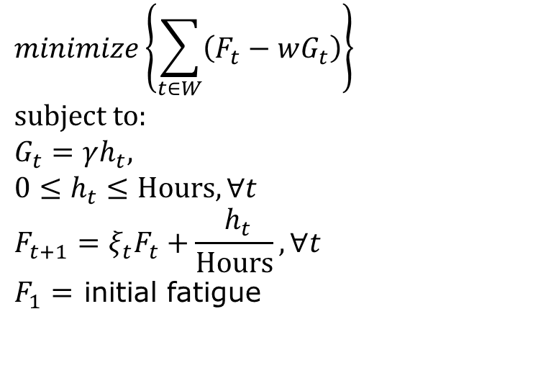
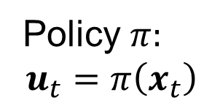
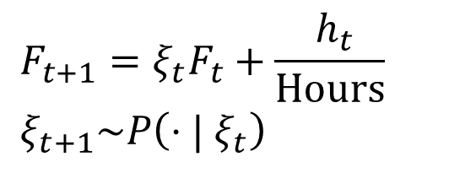
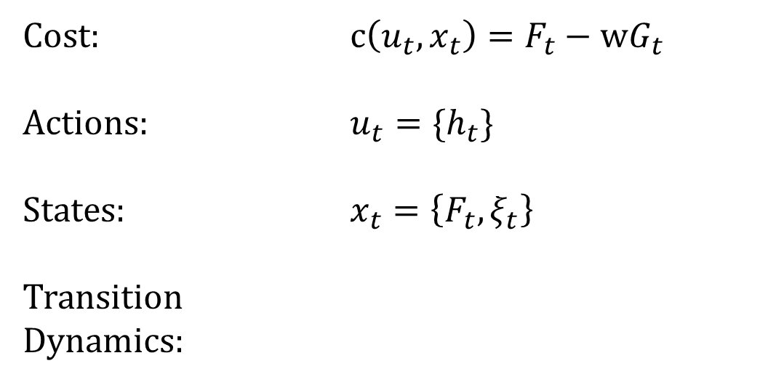
The student’s problem as a sequential decision problem
Deterministic Optimization Problem
Sequential Decision Problem
Variables:
Effort (hours) $h_{t }$
Grade $G_{t}$
Fatigue $F_{t}$
Uncertain Parameters (assumed known):
$ξ_{t}$ (Fatigue Accumulation factor)
Cost: $c\left(u_{t}, x_{t}\right)=F_{t}−wG_{t}$
Actions: ${u_{t}=\{h}_{t}\}$
States: $x_{t}=\left\{F_{t}, ξ_{t}\right\}$
Transition
Dynamics:
$$minimize\left\{\sum_{t∈W}{\left(F_{t}−wG_{t}\right)}\right\} \\ subject to:$$
$$G_{t}=γh_{t},$$
$$0≤h_{t}≤Hours, ∀t$$
$$F_{t+1}=ξ_{t}F_{t}+\frac{ h_{t}}{Hours}, ∀t$$
$F_{1}=$ initial fatigue
$$F_{t+1}=ξ_{t}F_{t}+\frac{ h_{t}}{Hours}$$
$$ξ_{t+1}\sim P\left(⋅| ξ_{t}\right)$$
$$x_{t+1}\sim P\left(⋅|x_{t}, u_{t}\right)$$
Policy $π:$
$$u_{t}=π\left(x_{t}\right)$$
$$h_{t}=π\left(F_{t}, ξ_{t}\right)$$
32

Slide 33
Exogenous vs Endogenous state variables
Deterministic Optimization Problem
Sequential Decision Problem
Variables:
Effort (hours) $h_{t }$
Grade $G_{t}$
Fatigue $F_{t}$
Uncertain Parameters (assumed known):
$ξ_{t}$ (Fatigue Accumulation factor)
Cost: $c\left(u_{t}, x_{t}\right)=F_{t}−wG_{t}$
Actions: ${u_{t}=\{h}_{t}\}$
States: $x_{t}=\left\{F_{t}, ξ_{t}\right\}$
Transition
Dynamics:
Endogenous or Exogenous?
$$minimize\left\{\sum_{t∈W}{\left(F_{t}−wG_{t}\right)}\right\} \\ subject to:$$
$$G_{t}=γh_{t},$$
$$0≤h_{t}≤Hours, ∀t$$
$$F_{t+1}=ξ_{t}F_{t}+\frac{ h_{t}}{Hours}, ∀t$$
$F_{1}=$ initial fatigue
$$F_{t+1}=ξ_{t}F_{t}+\frac{ h_{t}}{Hours}$$
$$ξ_{t+1}\sim P\left(⋅| ξ_{t}\right)$$
$$x_{t+1}\sim P\left(⋅|x_{t}, u_{t}\right)$$
33

Slide 34
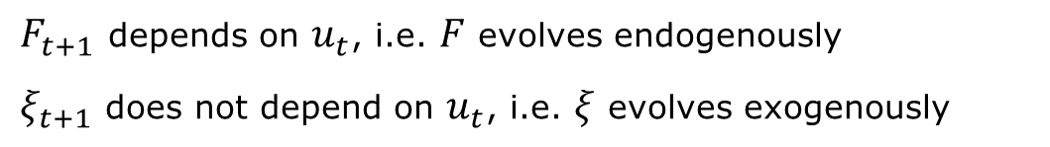
Exogenous vs Endogenous state variables
Deterministic Optimization Problem
Sequential Decision Problem
Variables:
Effort (hours) $h_{t }$
Grade $G_{t}$
Fatigue $F_{t}$
Uncertain Parameters (assumed known):
$ξ_{t}$ (Fatigue Accumulation factor)
Cost: $c\left(u_{t}, x_{t}\right)=F_{t}−wG_{t}$
Actions: ${u_{t}=\{h}_{t}\}$
States: $x_{t}=\left\{F_{t}, ξ_{t}\right\}$
Transition
Dynamics:
$$minimize\left\{\sum_{t∈W}{\left(F_{t}−wG_{t}\right)}\right\} \\ subject to:$$
$$G_{t}=γh_{t},$$
$$0≤h_{t}≤Hours, ∀t$$
$$F_{t+1}=ξ_{t}F_{t}+\frac{ h_{t}}{Hours}, ∀t$$
$F_{1}=$ initial fatigue
$$F_{t+1}=ξ_{t}F_{t}+\frac{ h_{t}}{Hours}$$
$$ξ_{t+1}\sim P\left(⋅| ξ_{t}\right)$$
$$x_{t+1}\sim P\left(⋅|x_{t}, u_{t}\right)$$
$F_{t+1}$ depends on $u_{t}$, i.e. $F$ evolves endogenously
$ξ_{t+1}$ does not depend on $u_{t}$, i.e. $ξ$ evolves exogenously
34

Slide 35
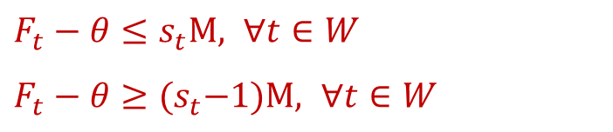
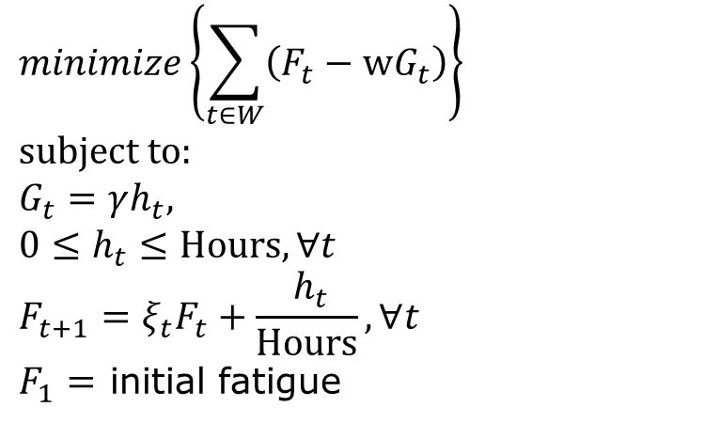

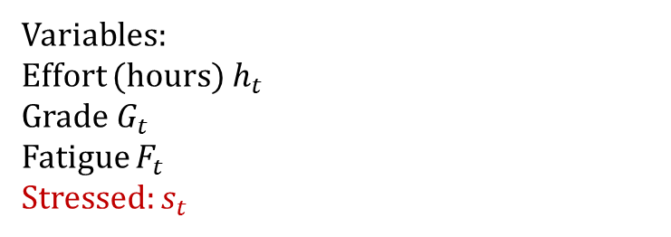
The student’s problem including stress
Deterministic Optimization Problem
Sequential Decision Problem
What is “stressed”?
Variables:
Effort (hours) $h_{t }$
Grade $G_{t}$
Fatigue $F_{t}$
Stressed: $s_{t}$
Cost: $c\left(u_{t}, x_{t}\right)=F_{t}−wG_{t}$
Actions: ${u_{t}=\{h}_{t}\}$
States: $x_{t}=\left\{F_{t}, ξ_{t}\right\}$
Transition
Dynamics:
$$minimize\left\{\sum_{t∈W}{\left(F_{t}−wG_{t}\right)}\right\} \\ subject to:$$
$$G_{t}=γh_{t},$$
$$0≤h_{t}≤Hours, ∀t$$
$$F_{t+1}=ξ_{t}F_{t}+\frac{ h_{t}}{Hours}, ∀t$$
$F_{1}=$ initial fatigue
$$F_{t+1}=ξ_{t}F_{t}+\frac{ h_{t}}{Hours}$$
$$ξ_{t+1}\sim P\left(⋅| ξ_{t}\right)$$
$$x_{t+1}\sim P\left(⋅|x_{t}, u_{t}\right)$$
$F_{t+1}$ depends on $u_{t}$, i.e. $F$ evolves endogenously
$ξ_{t+1}$ does not depend on $u_{t}$, i.e. $ξ$ evolves exogenously
$F_{t}−θ≤s_{t}M, ∀t∈W$
$F_{t}−θ≥{(s}_{t}−1)M, ∀t∈W$
35

Slide 36
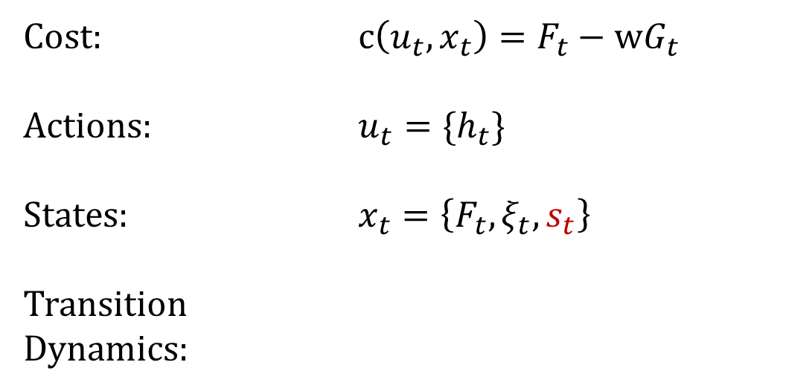
The student’s problem including stress
Deterministic Optimization Problem
Sequential Decision Problem
What is “stressed”?
Variables:
Effort (hours) $h_{t }$
Grade $G_{t}$
Fatigue $F_{t}$
Stressed: $s_{t}$
Cost: $c\left(u_{t}, x_{t}\right)=F_{t}−wG_{t}$
Actions: ${u_{t}=\{h}_{t}\}$
States: $x_{t}=\left\{F_{t}, ξ_{t}, s_{t}\right\}$
Transition
Dynamics:
$$minimize\left\{\sum_{t∈W}{\left(F_{t}−wG_{t}\right)}\right\} \\ subject to:$$
$$G_{t}=γh_{t},$$
$$0≤h_{t}≤Hours, ∀t$$
$$F_{t+1}=ξ_{t}F_{t}+\frac{ h_{t}}{Hours}, ∀t$$
$F_{1}=$ initial fatigue
$$F_{t+1}=ξ_{t}F_{t}+\frac{ h_{t}}{Hours}$$
$$ξ_{t+1}\sim P\left(⋅| ξ_{t}\right)$$
$$x_{t+1}\sim P\left(⋅|x_{t}, u_{t}\right)$$
$F_{t+1}$ depends on $u_{t}$, i.e. $F$ evolves endogenously
$ξ_{t+1}$ does not depend on $u_{t}$, i.e. $ξ$ evolves exogenously
$F_{t}−θ≤s_{t}M, ∀t∈W$
$F_{t}−θ≥{(s}_{t}−1)M, ∀t∈W$
36

Slide 37
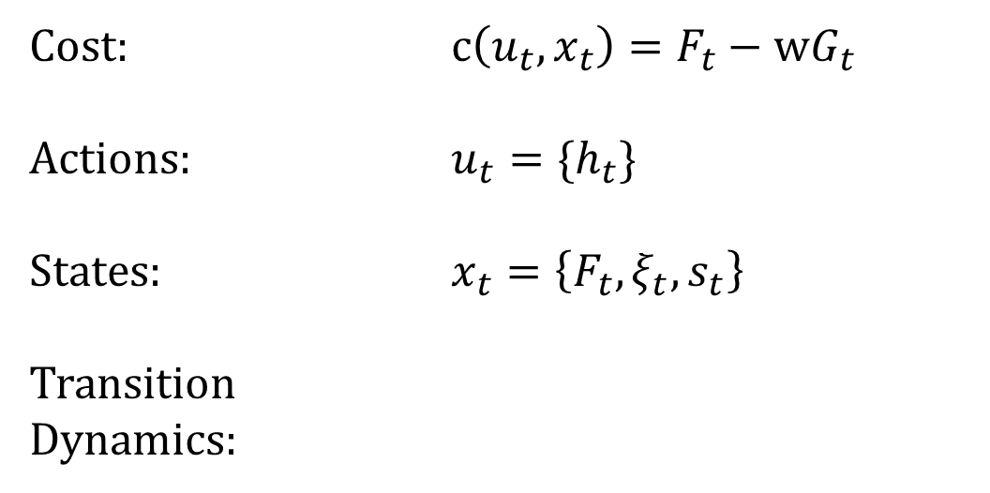
The student’s problem including stress
Deterministic Optimization Problem
Sequential Decision Problem
Variables:
Effort (hours) $h_{t }$
Grade $G_{t}$
Fatigue $F_{t}$
Stressed: $s_{t}$
Cost: $c\left(u_{t}, x_{t}\right)=F_{t}−wG_{t}$
Actions: ${u_{t}=\{h}_{t}\}$
States: $x_{t}=\left\{F_{t}, ξ_{t}, s_{t}\right\}$
Transition
Dynamics:
Is this formulation complete?
$$minimize\left\{\sum_{t∈W}{\left(F_{t}−wG_{t}\right)}\right\} \\ subject to:$$
$$G_{t}=γh_{t},$$
$$0≤h_{t}≤Hours, ∀t$$
$$F_{t+1}=ξ_{t}F_{t}+\frac{ h_{t}}{Hours}, ∀t$$
$F_{1}=$ initial fatigue
$$F_{t+1}=ξ_{t}F_{t}+\frac{ h_{t}}{Hours}$$
$$ξ_{t+1}\sim P\left(⋅| ξ_{t}\right)$$
$$x_{t+1}\sim P\left(⋅|x_{t}, u_{t}\right)$$
$F_{t+1}$ depends on $u_{t}$, i.e. $F$ evolves endogenously
$ξ_{t+1}$ does not depend on $u_{t}$, i.e. $ξ$ evolves exogenously
$F_{t}−θ≤s_{t}M, ∀t∈W$
$F_{t}−θ≥{(s}_{t}−1)M, ∀t∈W$
37

Slide 38


The student’s problem including stress
Deterministic Optimization Problem
Sequential Decision Problem
Variables:
Effort (hours) $h_{t }$
Grade $G_{t}$
Fatigue $F_{t}$
Stressed: $s_{t}$
Cost: $c\left(u_{t}, x_{t}\right)=F_{t}−wG_{t}$
Actions: ${u_{t}=\{h}_{t}\}$
States: $x_{t}=\left\{F_{t}, ξ_{t}, s_{t}\right\}$
Transition
Dynamics:
I must specify the dynamics for every state variable
$$minimize\left\{\sum_{t∈W}{\left(F_{t}−wG_{t}\right)}\right\} \\ subject to:$$
$$G_{t}=γh_{t},$$
$$0≤h_{t}≤Hours, ∀t$$
$$F_{t+1}=ξ_{t}F_{t}+\frac{ h_{t}}{Hours}, ∀t$$
$F_{1}=$ initial fatigue
$$F_{t+1}=ξ_{t}F_{t}+\frac{ h_{t}}{Hours}$$
$$ξ_{t+1}\sim P\left(⋅| ξ_{t}\right)$$
$$s_{t+1}=\left\{\begin{aligned}1, if F_{t+1}≥θ \\ 0, if F_{t+1}<θ\end{aligned}\right.$$
$$x_{t+1}\sim P\left(⋅|x_{t}, u_{t}\right)$$
$F_{t+1}$ depends on $u_{t}$, i.e. $F$ evolves endogenously
$ξ_{t+1}$ does not depend on $u_{t}$, i.e. $ξ$ evolves exogenously
$F_{t}−θ≤s_{t}M, ∀t∈W$
$F_{t}−θ≥{(s}_{t}−1)M, ∀t∈W$
38

Slide 39
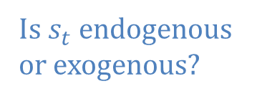
The student’s problem including stress
Deterministic Optimization Problem
Sequential Decision Problem
Variables:
Effort (hours) $h_{t }$
Grade $G_{t}$
Fatigue $F_{t}$
Stressed: $s_{t}$
Cost: $c\left(u_{t}, x_{t}\right)=F_{t}−wG_{t}$
Actions: ${u_{t}=\{h}_{t}\}$
States: $x_{t}=\left\{F_{t}, ξ_{t}, s_{t}\right\}$
Transition
Dynamics:
Is $s_{t}$ endogenous or exogenous?
$$minimize\left\{\sum_{t∈W}{\left(F_{t}−wG_{t}\right)}\right\} \\ subject to:$$
$$G_{t}=γh_{t},$$
$$0≤h_{t}≤Hours, ∀t$$
$$F_{t+1}=ξ_{t}F_{t}+\frac{ h_{t}}{Hours}, ∀t$$
$F_{1}=$ initial fatigue
$$F_{t+1}=ξ_{t}F_{t}+\frac{ h_{t}}{Hours}$$
$$ξ_{t+1}\sim P\left(⋅| ξ_{t}\right)$$
$$s_{t+1}=\left\{\begin{aligned}1, if F_{t+1}≥θ \\ 0, if F_{t+1}<θ\end{aligned}\right.$$
$$x_{t+1}\sim P\left(⋅|x_{t}, u_{t}\right)$$
$F_{t+1}$ depends on $u_{t}$, i.e. $F$ evolves endogenously
$ξ_{t+1}$ does not depend on $u_{t}$, i.e. $ξ$ evolves exogenously
$F_{t}−θ≤s_{t}M, ∀t∈W$
$F_{t}−θ≥{(s}_{t}−1)M, ∀t∈W$
39

Slide 40
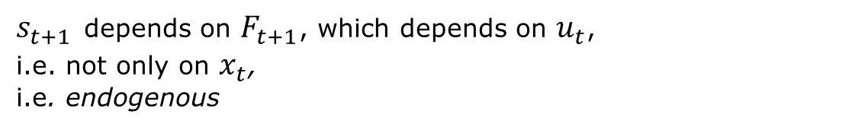
The student’s problem including stress
Deterministic Optimization Problem
Sequential Decision Problem
Variables:
Effort (hours) $h_{t }$
Grade $G_{t}$
Fatigue $F_{t}$
Stressed: $s_{t}$
Cost: $c\left(u_{t}, x_{t}\right)=F_{t}−wG_{t}$
Actions: ${u_{t}=\{h}_{t}\}$
States: $x_{t}=\left\{F_{t}, ξ_{t}, s_{t}\right\}$
Transition
Dynamics:
Is $s_{t}$ endogenous or exogenous?
$$minimize\left\{\sum_{t∈W}{\left(F_{t}−wG_{t}\right)}\right\} \\ subject to:$$
$$G_{t}=γh_{t},$$
$$0≤h_{t}≤Hours, ∀t$$
$$F_{t+1}=ξ_{t}F_{t}+\frac{ h_{t}}{Hours}, ∀t$$
$F_{1}=$ initial fatigue
$$F_{t+1}=ξ_{t}F_{t}+\frac{ h_{t}}{Hours}$$
$$ξ_{t+1}\sim P\left(⋅| ξ_{t}\right)$$
$$s_{t+1}=\left\{\begin{aligned}1, if F_{t+1}≥θ \\ 0, if F_{t+1}<θ\end{aligned}\right.$$
$$x_{t+1}\sim P\left(⋅|x_{t}, u_{t}\right)$$
$s_{t+1}$ depends on $F_{t+1}$, which depends on $u_{t}$,
i.e. not only on $x_{t}$,
i.e. endogenous
$F_{t}−θ≤s_{t}M, ∀t∈W$
$F_{t}−θ≥{(s}_{t}−1)M, ∀t∈W$
40

Slide 41
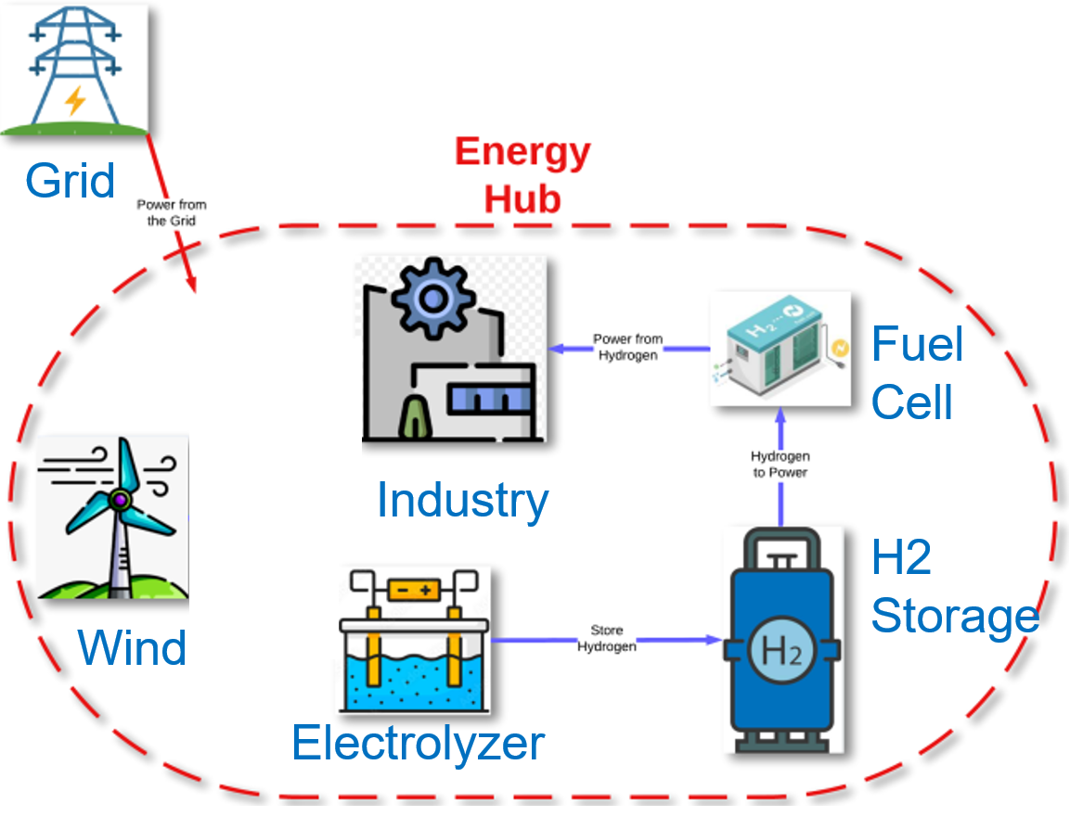
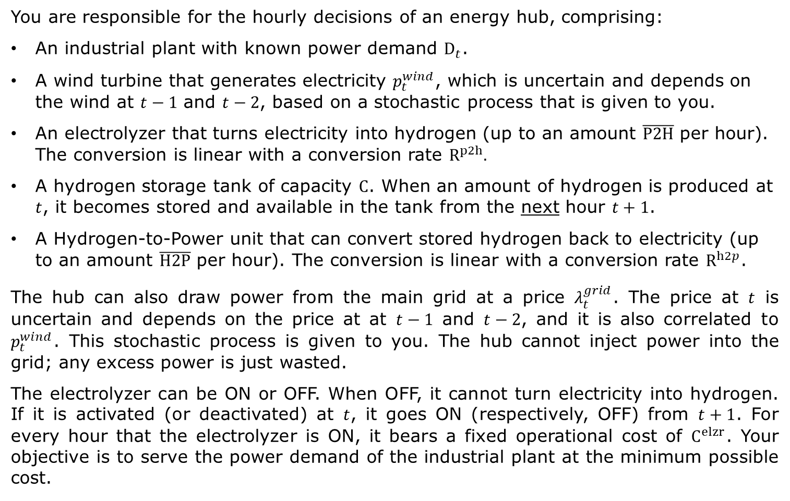
The Lead Example
You are responsible for the hourly decisions of an energy hub, comprising:
An industrial plant with known power demand $D_{t}$.
A wind turbine that generates electricity $p_{t}^{wind}$, which is uncertain and depends on the wind at $t−1$ and $t−2$, based on a stochastic process that is given to you.
An electrolyzer that turns electricity into hydrogen (up to an amount $\overline{P2H}$ per hour). The conversion is linear with a conversion rate $R^{p2h}.$
A hydrogen storage tank of capacity $C$. When an amount of hydrogen is produced at $t$, it becomes stored and available in the tank from the next hour $t+1$.
A Hydrogen-to-Power unit that can convert stored hydrogen back to electricity (up to an amount $\overline{H2P}$ per hour). The conversion is linear with a conversion rate $R^{h2p}$.
The hub can also draw power from the main grid at a price $λ_{t}^{grid}$. The price at $t$ is uncertain and depends on the price at at $t−1$ and $t−2$, and it is also correlated to $p_{t}^{wind}$. This stochastic process is given to you. The hub cannot inject power into the grid; any excess power is just wasted.
The electrolyzer can be ON or OFF. When OFF, it cannot turn electricity into hydrogen. If it is activated (or deactivated) at $t$, it goes ON (respectively, OFF) from $t+1$. For every hour that the electrolyzer is ON, it bears a fixed operational cost of $C^{elzr}$. Your objective is to serve the power demand of the industrial plant at the minimum possible cost.

Slide 42
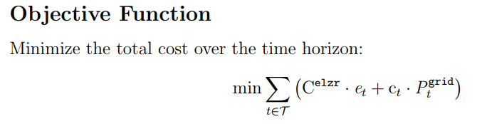
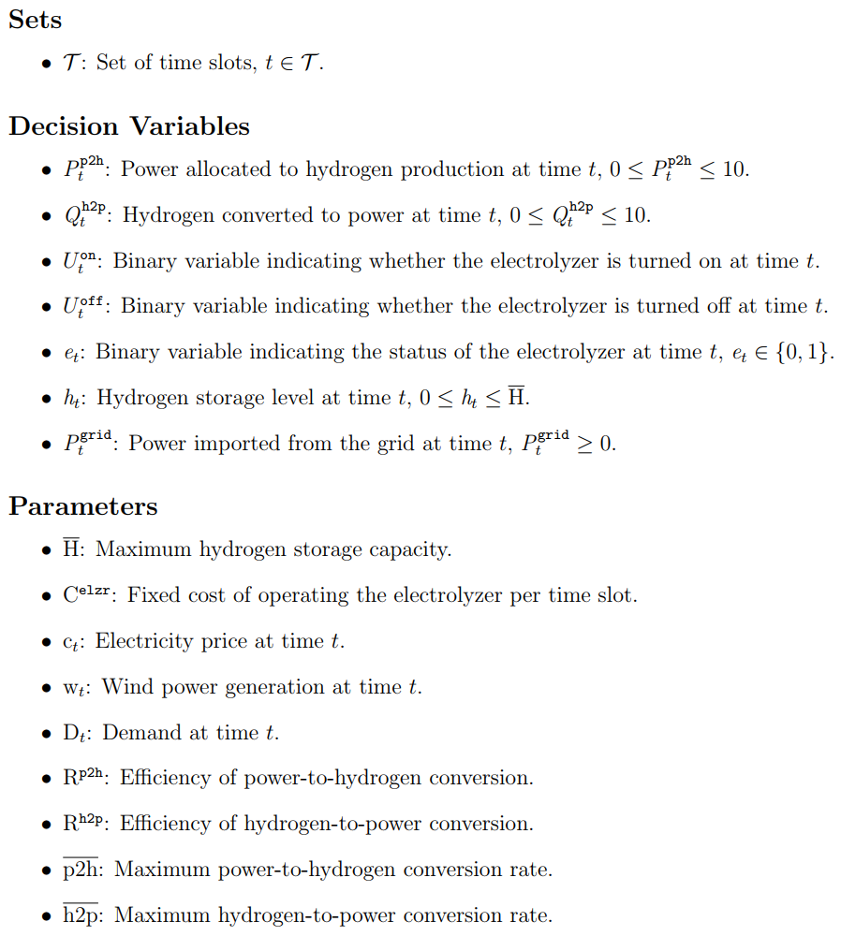
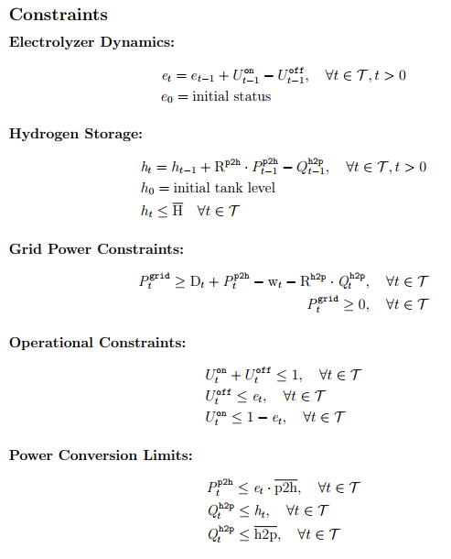
The Lead Example: Deterministic Optimization

Slide 43
Agent vs Environment
43

Slide 44
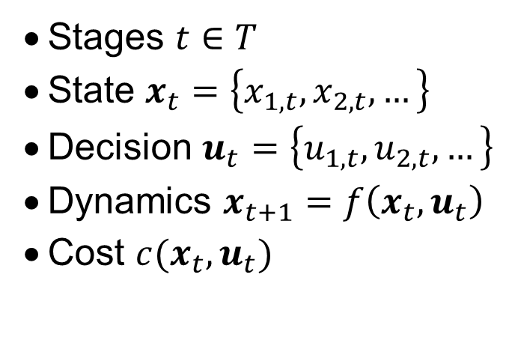
Back to the Big Picture
MDP
Define
Design
Evaluate
Stages $t∈T$
State $x_{t}=\left\{x_{1, t}, x_{2,t}, …\right\}$
Decision $u_{t}=\left\{u_{1, t}, u_{2,t}, …\right\}$
Dynamics $x_{t+1}=f\left(x_{t}, u_{t}\right)$
Cost $c(x_{t}, u_{t})$
44
Notes:
44

Slide 45
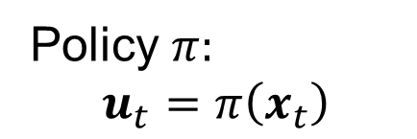
Back to the Big Picture
MDP
Agent
Define
Design
Evaluate
Stages $t∈T$
State $x_{t}=\left\{x_{1, t}, x_{2,t}, …\right\}$
Decision $u_{t}=\left\{u_{1, t}, u_{2,t}, …\right\}$
Dynamics $x_{t+1}=f\left(x_{t}, u_{t}\right)$
Cost $c(x_{t}, u_{t})$
Policy $π:$
$$u_{t}=π\left(x_{t}\right)$$
45
Notes:
45

Slide 46
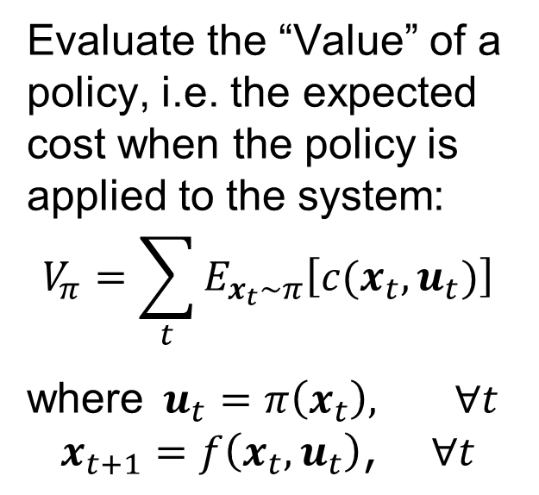
Back to the Big Picture
MDP
Agent
Define
Design
Evaluate
Stages $t∈T$
State $x_{t}=\left\{x_{1, t}, x_{2,t}, …\right\}$
Decision $u_{t}=\left\{u_{1, t}, u_{2,t}, …\right\}$
Dynamics $x_{t+1}=f\left(x_{t}, u_{t}\right)$
Cost $c(x_{t}, u_{t})$
Policy $π:$
$$u_{t}=π\left(x_{t}\right)$$
Evaluate the “Value” of a policy, i.e. the expected cost when the policy is applied to the system:
$$V_{π}=\sum_{t}{E_{x_{t}\sim π}\left[c(x_{t}, u_{t})\right]}$$
where$u_{t}=π\left(x_{t}\right), ∀t$
$$x_{t+1}=f\left(x_{t}, u_{t}\right)\text{, } ∀t$$
46
Notes:
46

Slide 47
Back to the Big Picture
MDP
Agent
Environment
Define
Design
Evaluate
Stages $t∈T$
State $x_{t}=\left\{x_{1, t}, x_{2,t}, …\right\}$
Decision $u_{t}=\left\{u_{1, t}, u_{2,t}, …\right\}$
Dynamics $x_{t+1}=f\left(x_{t}, u_{t}\right)$
Cost $c(x_{t}, u_{t})$
Policy $π:$
$$u_{t}=π\left(x_{t}\right)$$
Evaluate the “Value” of a policy, i.e. the expected cost when the policy is applied to the system:
$$V_{π}=\sum_{t}{E_{x_{t}\sim π}\left[c(x_{t}, u_{t})\right]}$$
where$u_{t}=π\left(x_{t}\right), ∀t$
$$x_{t+1}=f\left(x_{t}, u_{t}\right)\text{, } ∀t$$
47
Notes:
47

Slide 48
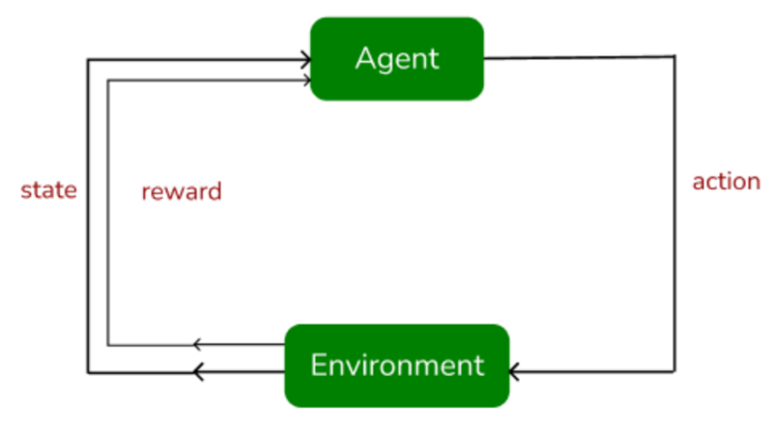

Agent vs Environment
The agent implements a policy $π:$ $u_{t}=π\left(x_{t}\right)$
i.e. receives the state as input and provides the action/decision as output
The environment is a simulator of the real system
i.e. the agent’s action is applied to it (input) and it returns the next state and the reward (output).

Slide 49
Agent vs Environment
The agent implements a policy $π:$ $u_{t}=π\left(x_{t}\right)$
i.e. receives the state as input and provides the action/decision as output
The agent may internally model the environment (namely, the state dynamics) to account for the future. But it does not have perfect foresight over the future.
The environment is a simulator of the real system
i.e. the agent’s action is applied to it (input) and it returns the next state and the reward (output).

Slide 50



The student’s problem
Cost: $c\left(u_{t}, x_{t}\right)=F_{t}−wG_{t}$
Actions: ${u_{t}=\{h}_{t}\}$
States: $x_{t}=\left\{F_{t}, ξ_{t}\right\}$
Transition
Dynamics:
$$F_{t+1}=ξ_{t}F_{t}+\frac{ h_{t}}{Hours}$$
$$ξ_{t+1}\sim P\left(⋅| ξ_{t}\right)$$

Slide 51
The student’s problem
Cost: $c\left(u_{t}, x_{t}\right)=F_{t}−wG_{t}$
Actions: ${u_{t}=\{h}_{t}\}$
States: $x_{t}=\left\{F_{t}, ξ_{t}\right\}$
Transition
Dynamics:
You observe your state
$$F_{t+1}=ξ_{t}F_{t}+\frac{ h_{t}}{Hours}$$
$$ξ_{t+1}\sim P\left(⋅| ξ_{t}\right)$$
51

Slide 52
The student’s problem
You reason about how your action will affect your reward and perhaps also how it may affect your next state and beyond
Cost: $c\left(u_{t}, x_{t}\right)=F_{t}−wG_{t}$
Actions: ${u_{t}=\{h}_{t}\}$
States: $x_{t}=\left\{F_{t}, ξ_{t}\right\}$
Transition
Dynamics:
You observe your state
$$F_{t+1}=ξ_{t}F_{t}+\frac{ h_{t}}{Hours}$$
$$ξ_{t+1}\sim P\left(⋅| ξ_{t}\right)$$
52

Slide 53
The student’s problem
You reason about how your action will affect your reward and perhaps also how it may affect your next state and beyond
Cost: $c\left(u_{t}, x_{t}\right)=F_{t}−wG_{t}$
Actions: ${u_{t}=\{h}_{t}\}$
States: $x_{t}=\left\{F_{t}, ξ_{t}\right\}$
Transition
Dynamics:
You observe your state
You apply an action
$$F_{t+1}=ξ_{t}F_{t}+\frac{ h_{t}}{Hours}$$
$$ξ_{t+1}\sim P\left(⋅| ξ_{t}\right)$$
53

Slide 54
The student’s problem
You reason about how your action will affect your reward and perhaps also how it may affect your next state and beyond
Cost: $c\left(u_{t}, x_{t}\right)=F_{t}−wG_{t}$
Actions: ${u_{t}=\{h}_{t}\}$
States: $x_{t}=\left\{F_{t}, ξ_{t}\right\}$
Transition
Dynamics:
You observe your state
You apply an action
$$F_{t+1}=ξ_{t}F_{t}+\frac{ h_{t}}{Hours}$$
$$ξ_{t+1}\sim P\left(⋅| ξ_{t}\right)$$
Next week, you observe your new (realized) state. Which is generally different than the one you might have predicted.
54

Slide 55
The student’s problem
Cost: $c\left(u_{t}, x_{t}\right)=F_{t}−wG_{t}$
Actions: ${u_{t}=\{h}_{t}\}$
States: $x_{t}=\left\{F_{t}, ξ_{t}\right\}$
Transition
Dynamics:
You observe your state
$$F_{t+1}=ξ_{t}F_{t}+\frac{ h_{t}}{Hours}$$
$$ξ_{t+1}\sim P\left(⋅| ξ_{t}\right)$$
55

Slide 56









The student’s problem
You reason about how your action will affect your reward and perhaps also how it may affect your next state and beyond
$$g_{t}−α\sum_{c∈C}{h_{t,c}}$$
Reward
Action
Effort
$$h_{t,c}$$
You observe your state
You apply an action
State
$Hours_{t}$, $stressed: s_{t}$, $h_{t,c}^{prev}{, θ}_{t}$
$$g_{t}=\sum_{c∈C}{\frac{h_{t,c}}{{Difficulty}_{c}}}⋅{weight}_{c}, \\ \sum_{c∈C}{h_{t,c}≤}{Hours}_{t}(1−s_{t}),∀t∈W \\ \sum_{t∉\left[{start}_{c}, {end}_{c}\right]}{h_{t,c}=0} ∀c∈C$$
Constraints
Where do these live?
Next week, you observe your new (realized) state. Which is generally different than the one you might have predicted.
Dynamics
$$Hours_{t+1}\sim P\left(⋅|Hours_{t}\right)$$
$$θ_{t+1}\sim P\left(⋅|θ_{t}\right)$$
$$s_{t+1}=g(h_{t,c}^{prev}+h_{t,c},θ_{t})$$
$h_{t+1,c }^{prev}$ = $h_{t,c}$

Slide 57
The student’s problem
You reason about how your action will affect your reward and perhaps also how it may affect your next state and beyond
Work 100 hours each and every week
You observe your state
You apply an action
What is the cost of this action?
What is the next state?
Next week, you observe your new (realized) state. Which is generally different than the one you might have predicted.

Slide 58
The student’s problem
You reason about how your action will affect your reward and perhaps also how it may affect your next state and beyond
Work 100 hours each and every week
You observe your state
You apply an action
What is the cost of this action?
What is the next state?
Detect infeasible actions, kill the simulation and print an error
Map any action into the feasible space
Next week, you observe your new (realized) state. Which is generally different than the one you might have predicted.

Slide 59
Lead Example
59

Slide 60

The Lead Example
You are responsible for the hourly decisions of an energy hub, comprising:
An industrial plant with known power demand $D_{t}$.
A wind turbine that generates electricity $p_{t}^{wind}$, which is uncertain and depends on the wind at $t−1$ and $t−2$, based on a stochastic process that is given to you.
An electrolyzer that turns electricity into hydrogen (up to an amount $\overline{P2H}$ per hour). The conversion is linear with a conversion rate $R^{p2h}.$
A hydrogen storage tank of capacity $C$. When an amount of hydrogen is produced at $t$, it becomes stored and available in the tank from the next hour $t+1$.
A Hydrogen-to-Power unit that can convert stored hydrogen back to electricity (up to an amount $\overline{H2P}$ per hour). The conversion is linear with a conversion rate $R^{h2p}$.
The hub can also draw power from the main grid at a price $λ_{t}^{grid}$. The price at $t$ is uncertain and depends on the price at at $t−1$ and $t−2$, and it is also correlated to $p_{t}^{wind}$. This stochastic process is given to you. The hub cannot inject power into the grid; any excess power is just wasted.
The electrolyzer can be ON or OFF. When OFF, it cannot turn electricity into hydrogen. If it is activated (or deactivated) at $t$, it goes ON (respectively, OFF) from $t+1$. For every hour that the electrolyzer is ON, it bears a fixed operational cost of $C^{elzr}$. Your objective is to serve the power demand of the industrial plant at the minimum possible cost.
Stages $t∈𝒯$
State $x_{t}=\left\{x_{1, t}, x_{2,t}, …\right\}$
Decision
$u_{t}=\left\{u_{1, t}, u_{2,t}, …\right\}$
Dynamics
$x_{t+1}=f\left(x_{t}, u_{t}\right)$
Cost $c(x_{t}, u_{t})$

Slide 61
The Lead Example: Deterministic Optimization

Slide 62


The Lead Example
You are responsible for the hourly decisions of an energy hub, comprising:
An industrial plant with known power demand $D_{t}$.
A wind turbine that generates electricity $p_{t}^{wind}$, which is uncertain and depends on the wind at $t−1$ and $t−2$, based on a stochastic process that is given to you.
An electrolyzer that turns electricity into hydrogen (up to an amount $\overline{P2H}$ per hour). The conversion is linear with a conversion rate $R^{p2h}.$
A hydrogen storage tank of capacity $C$. When an amount of hydrogen is produced at $t$, it becomes stored and available in the tank from the next hour $t+1$.
A Hydrogen-to-Power unit that can convert stored hydrogen back to electricity (up to an amount $\overline{H2P}$ per hour). The conversion is linear with a conversion rate $R^{h2p}$.
The hub can also draw power from the main grid at a price $λ_{t}^{grid}$. The price at $t$ is uncertain and depends on the price at at $t−1$ and $t−2$, and it is also correlated to $p_{t}^{wind}$. This stochastic process is given to you. The hub cannot inject power into the grid; any excess power is just wasted.
The electrolyzer can be ON or OFF. When OFF, it cannot turn electricity into hydrogen. If it is activated (or deactivated) at $t$, it goes ON (respectively, OFF) from $t+1$. For every hour that the electrolyzer is ON, it bears a fixed operational cost of $C^{elzr}$. Your objective is to serve the power demand of the industrial plant at the minimum possible cost.
Stages $t∈𝒯$
State $x_{t}=\left\{x_{1, t}, x_{2,t}, …\right\}$
Decision
$u_{t}=\left\{u_{1, t}, u_{2,t}, …\right\}$
Dynamics
$x_{t+1}=f\left(x_{t}, u_{t}\right)$
Cost $c(x_{t}, u_{t})$

Slide 63







The Lead Example
You are responsible for the hourly decisions of an energy hub, comprising:
An industrial plant with known power demand $D_{t}$.
A wind turbine that generates electricity $p_{t}^{wind}$, which is uncertain and depends on the wind at $t−1$ and $t−2$, based on a stochastic process that is given to you.
An electrolyzer that turns electricity into hydrogen (up to an amount $\overline{P2H}$ per hour). The conversion is linear with a conversion rate $R^{p2h}.$
A hydrogen storage tank of capacity $C$. When an amount of hydrogen is produced at $t$, it becomes stored and available in the tank from the next hour $t+1$.
A Hydrogen-to-Power unit that can convert stored hydrogen back to electricity (up to an amount $\overline{H2P}$ per hour). The conversion is linear with a conversion rate $R^{h2p}$.
The hub can also draw power from the main grid at a price $λ_{t}^{grid}$. The price at $t$ is uncertain and depends on the price at at $t−1$ and $t−2$, and it is also correlated to $p_{t}^{wind}$. This stochastic process is given to you. The hub cannot inject power into the grid; any excess power is just wasted.
The electrolyzer can be ON or OFF. When OFF, it cannot turn electricity into hydrogen. If it is activated (or deactivated) at $t$, it goes ON (respectively, OFF) from $t+1$. For every hour that the electrolyzer is ON, it bears a fixed operational cost of $C^{elzr}$. Your objective is to serve the power demand of the industrial plant at the minimum possible cost.
$$p_{t}^{p2h}$$
$$h_{t}^{h2p}$$
$$p_{t}^{grid}$$
Stages $t∈𝒯$
State
$x_{t}=\left\{x_{1, t}, x_{2,t}, …\right\}$
Decision
$u_{t}=\left\{u_{1, t}, u_{2,t}, …\right\}$
Dynamics
$x_{t+1}=f\left(x_{t}, u_{t}\right)$
Cost $c(x_{t}, u_{t})$
$$y_{t}^{act}$$
$$y_{t}^{de}$$

Slide 64
The Lead Example
You are responsible for the hourly decisions of an energy hub, comprising:
An industrial plant with known power demand $D_{t}$.
A wind turbine that generates electricity $p_{t}^{wind}$, which is uncertain and depends on the wind at $t−1$ and $t−2$, based on a stochastic process that is given to you.
An electrolyzer that turns electricity into hydrogen (up to an amount $\overline{P2H}$ per hour). The conversion is linear with a conversion rate $R^{p2h}.$
A hydrogen storage tank of capacity $C$. When an amount of hydrogen is produced at $t$, it becomes stored and available in the tank from the next hour $t+1$.
A Hydrogen-to-Power unit that can convert stored hydrogen back to electricity (up to an amount $\overline{H2P}$ per hour). The conversion is linear with a conversion rate $R^{h2p}$.
The hub can also draw power from the main grid at a price $λ_{t}^{grid}$. The price at $t$ is uncertain and depends on the price at at $t−1$ and $t−2$, and it is also correlated to $p_{t}^{wind}$. This stochastic process is given to you. The hub cannot inject power into the grid; any excess power is just wasted.
The electrolyzer can be ON or OFF. When OFF, it cannot turn electricity into hydrogen. If it is activated (or deactivated) at $t$, it goes ON (respectively, OFF) from $t+1$. For every hour that the electrolyzer is ON, it bears a fixed operational cost of $C^{elzr}$. Your objective is to serve the power demand of the industrial plant at the minimum possible cost.
How many State
variables do
we need?
$$p_{t}^{p2h}$$
$$h_{t}^{h2p}$$
$$p_{t}^{grid}$$
Stages $t∈𝒯$
State
$x_{t}=\left\{x_{1, t}, x_{2,t}, …\right\}$
Decision
$u_{t}=\left\{u_{1, t}, u_{2,t}, …\right\}$
Dynamics
$x_{t+1}=f\left(x_{t}, u_{t}\right)$
Cost $c(x_{t}, u_{t})$
$$y_{t}^{act}$$
$$y_{t}^{de}$$

Slide 65








The Lead Example
You are responsible for the hourly decisions of an energy hub, comprising:
An industrial plant with known power demand $D_{t}$.
A wind turbine that generates electricity $p_{t}^{wind}$, which is uncertain and depends on the wind at $t−1$ and $t−2$, based on a stochastic process that is given to you.
An electrolyzer that turns electricity into hydrogen (up to an amount $\overline{P2H}$ per hour). The conversion is linear with a conversion rate $R^{p2h}.$
A hydrogen storage tank of capacity $C$. When an amount of hydrogen is produced at $t$, it becomes stored and available in the tank from the next hour $t+1$.
A Hydrogen-to-Power unit that can convert stored hydrogen back to electricity (up to an amount $\overline{H2P}$ per hour). The conversion is linear with a conversion rate $R^{h2p}$.
The hub can also draw power from the main grid at a price $λ_{t}^{grid}$. The price at $t$ is uncertain and depends on the price at at $t−1$ and $t−2$, and it is also correlated to $p_{t}^{wind}$. This stochastic process is given to you. The hub cannot inject power into the grid; any excess power is just wasted.
The electrolyzer can be ON or OFF. When OFF, it cannot turn electricity into hydrogen. If it is activated (or deactivated) at $t$, it goes ON (respectively, OFF) from $t+1$. For every hour that the electrolyzer is ON, it bears a fixed operational cost of $C^{elzr}$. Your objective is to serve the power demand of the industrial plant at the minimum possible cost.
$$p_{t}^{wind}$$
$$p_{t}^{prev}$$
$$p_{t}^{p2h}$$
$$h_{t}$$
$$h_{t}^{h2p}$$
$$p_{t}^{grid}$$
Stages $t∈𝒯$
State
$x_{t}=\left\{x_{1, t}, x_{2,t}, …\right\}$
Decision
$u_{t}=\left\{u_{1, t}, u_{2,t}, …\right\}$
Dynamics
$x_{t+1}=f\left(x_{t}, u_{t}\right)$
Cost $c(x_{t}, u_{t})$
$$λ_{t}^{grid}$$
$$λ_{t}^{prev}$$
$$y_{t}$$
$$y_{t}^{act}$$
$$y_{t}^{de}$$

Slide 66






The Lead Example
You are responsible for the hourly decisions of an energy hub, comprising:
An industrial plant with known power demand $D_{t}$.
A wind turbine that generates electricity $p_{t}^{wind}$, which is uncertain and depends on the wind at $t−1$ and $t−2$, based on a stochastic process that is given to you.
An electrolyzer that turns electricity into hydrogen (up to an amount $\overline{P2H}$ per hour). The conversion is linear with a conversion rate $R^{p2h}.$
A hydrogen storage tank of capacity $C$. When an amount of hydrogen is produced at $t$, it becomes stored and available in the tank from the next hour $t+1$.
A Hydrogen-to-Power unit that can convert stored hydrogen back to electricity (up to an amount $\overline{H2P}$ per hour). The conversion is linear with a conversion rate $R^{h2p}$.
The hub can also draw power from the main grid at a price $λ_{t}^{grid}$. The price at $t$ is uncertain and depends on the price at at $t−1$ and $t−2$, and it is also correlated to $p_{t}^{wind}$. This stochastic process is given to you. The hub cannot inject power into the grid; any excess power is just wasted.
The electrolyzer can be ON or OFF. When OFF, it cannot turn electricity into hydrogen. If it is activated (or deactivated) at $t$, it goes ON (respectively, OFF) from $t+1$. For every hour that the electrolyzer is ON, it bears a fixed operational cost of $C^{elzr}$. Your objective is to serve the power demand of the industrial plant at the minimum possible cost.
$$p_{t+1}^{wind}\sim P\left(⋅|p_{t}^{wind},p_{t}^{prev}\right)$$
$$p_{t}^{wind}$$
$$p_{t+1}^{prev}=p_{t}^{wind}$$
$$p_{t}^{prev}$$
$$p_{t}^{p2h}$$
$h_{t+1}=h_{t}+$ $p_{t}^{p2h}R^{p2h}−h_{t}^{h2p}$
$$h_{t}$$
$$h_{t}^{h2p}$$
$$p_{t}^{grid}$$
$$λ_{t+1}^{grid}\sim \\ P\left(⋅|λ_{t}^{grid},λ_{t}^{prev},p_{t}^{wind},p_{t}^{prev}\right)$$
$$λ_{t}^{grid}$$
$$λ_{t}^{prev}$$
$$λ_{t+1}^{prev}=λ_{t}^{grid}$$
$$y_{t}$$
$y_{t+1}=y_{t}+y_{t}^{act}−$ $y_{t}^{de}$
$$y_{t}^{act}$$
$$y_{t}^{de}$$

Slide 67




The Lead Example
You are responsible for the hourly decisions of an energy hub, comprising:
An industrial plant with known power demand $D_{t}$.
A wind turbine that generates electricity $p_{t}^{wind}$, which is uncertain and depends on the wind at $t−1$ and $t−2$, based on a stochastic process that is given to you.
An electrolyzer that turns electricity into hydrogen (up to an amount $\overline{P2H}$ per hour). The conversion is linear with a conversion rate $R^{p2h}.$
A hydrogen storage tank of capacity $C$. When an amount of hydrogen is produced at $t$, it becomes stored and available in the tank from the next hour $t+1$.
A Hydrogen-to-Power unit that can convert stored hydrogen back to electricity (up to an amount $\overline{H2P}$ per hour). The conversion is linear with a conversion rate $R^{h2p}$.
The hub can also draw power from the main grid at a price $λ_{t}^{grid}$. The price at $t$ is uncertain and depends on the price at at $t−1$ and $t−2$, and it is also correlated to $p_{t}^{wind}$. This stochastic process is given to you. The hub cannot inject power into the grid; any excess power is just wasted.
The electrolyzer can be ON or OFF. When OFF, it cannot turn electricity into hydrogen. If it is activated (or deactivated) at $t$, it goes ON (respectively, OFF) from $t+1$. For every hour that the electrolyzer is ON, it bears a fixed operational cost of $C^{elzr}$. Your objective is to serve the power demand of the industrial plant at the minimum possible cost.
$$p_{t+1}^{wind}\sim P\left(⋅|p_{t}^{wind},p_{t}^{prev}\right)$$
$$p_{t}^{wind}$$
$$p_{t+1}^{prev}=p_{t}^{wind}$$
$$p_{t}^{prev}$$
$$p_{t}^{p2h}≤\overline{P2H}$$
$$p_{t}^{p2h}$$
$h_{t+1}=h_{t}+$ $p_{t}^{p2h}R^{p2h}−h_{t}^{h2p}$
$$h_{t}^{h2p}≤\overline{H2P}$$
$$h_{t}$$
$$p_{t}^{grid}=D_{t}+p_{t}^{p2h} −p_{t}^{wind} −R^{h2p}h_{t}^{h2p}$$
$$h_{t}^{h2p}$$
$$p_{t}^{grid}$$
$$λ_{t+1}^{grid}\sim \\ P\left(⋅|λ_{t}^{grid},λ_{t}^{prev},p_{t}^{wind},p_{t}^{prev}\right)$$
$$λ_{t}^{grid}$$
$$λ_{t}^{prev}$$
$$λ_{t+1}^{prev}=λ_{t}^{grid}$$
$$y_{t}$$
$y_{t+1}=y_{t}+y_{t}^{act}−$ $y_{t}^{de}$
$$y_{t}^{act}$$
$$y_{t}^{act}, y_{t}^{de}∈\left\{0,1\right\}$$
$$y_{t}^{act}⋅ y_{t}^{de}=0$$
$$y_{t}^{de}$$

Slide 68

The Lead Example as an MDP
$$p_{t+1}^{wind}\sim P\left(⋅|p_{t}^{wind},p_{t}^{prev}\right)$$
Stages $t∈𝒯$
State $x_{t}=\left\{p_{t}^{wind},p_{t}^{prev},h_{t},λ_{t}^{grid},λ_{t}^{prev}, y_{t}\right\}$
Decision
$u_{t}=\left\{p_{t}^{p2h},h_{t}^{h2p},p_{t}^{grid},y_{t}^{act}, y_{t}^{de}\right\}$
Dynamics
$p_{t+1}^{wind}\sim P\left(⋅|p_{t}^{wind},p_{t}^{prev}\right)$
$p_{t+1}^{prev}=p_{t}^{wind}$
$h_{t+1}=h_{t}+ p_{t}^{p2h}R^{p2h}−h_{t}^{h2p}$
$λ_{t+1}^{grid}\sim P\left(⋅|λ_{t}^{grid},λ_{t}^{prev},p_{t}^{wind},p_{t}^{prev}\right)$
$λ_{t+1}^{prev}=λ_{t}^{grid}$
$y_{t+1}=y_{t}+y_{t}^{act}− y_{t}^{de}$
Cost $c\left(x_{t}, u_{t}\right)=λ_{t}^{grid}⋅p_{t}^{grid}$
$$p_{t}^{wind}$$
$$p_{t+1}^{prev}=p_{t}^{wind}$$
$$p_{t}^{prev}$$
$$p_{t}^{p2h}≤\overline{P2H}$$
$$p_{t}^{p2h}$$
$h_{t+1}=h_{t}+$ $p_{t}^{p2h}R^{p2h}−h_{t}^{h2p}$
$$h_{t}^{h2p}≤\overline{H2P}$$
$$h_{t}$$
$$p_{t}^{grid}=D_{t}+p_{t}^{p2h} −p_{t}^{wind} −R^{h2p}h_{t}^{h2p}$$
$$h_{t}^{h2p}$$
$$p_{t}^{grid}$$
$$λ_{t+1}^{grid}\sim \\ P\left(⋅|λ_{t}^{grid},λ_{t}^{prev},p_{t}^{wind},p_{t}^{prev}\right)$$
$$λ_{t}^{grid}$$
$$λ_{t}^{prev}$$
$$λ_{t+1}^{prev}=λ_{t}^{grid}$$
$$y_{t}$$
$y_{t+1}=y_{t}+y_{t}^{act}−$ $y_{t}^{de}$
$$y_{t}^{act}$$
$$y_{t}^{act}, y_{t}^{de}∈\left\{0,1\right\}$$
$$y_{t}^{act}⋅ y_{t}^{de}=0$$
$$y_{t}^{de}$$

Slide 69

The Lead Example as an MDP
$$p_{t+1}^{wind}\sim P\left(⋅|p_{t}^{wind},p_{t}^{prev}\right)$$
Stages $t∈𝒯$
State $x_{t}=\left\{p_{t}^{wind},p_{t}^{prev},h_{t},λ_{t}^{grid},λ_{t}^{prev}, y_{t}\right\}$
Decision
$u_{t}=\left\{p_{t}^{p2h},h_{t}^{h2p},p_{t}^{grid},y_{t}^{act}, y_{t}^{de}\right\}$
Dynamics
$p_{t+1}^{wind}\sim P\left(⋅|p_{t}^{wind},p_{t}^{prev}\right)$
$p_{t+1}^{prev}=p_{t}^{wind}$
$h_{t+1}=h_{t}+ p_{t}^{p2h}R^{p2h}−h_{t}^{h2p}$
$λ_{t+1}^{grid}\sim P\left(⋅|λ_{t}^{grid},λ_{t}^{prev},p_{t}^{wind},p_{t}^{prev}\right)$
$λ_{t+1}^{prev}=λ_{t}^{grid}$
$y_{t+1}=y_{t}+y_{t}^{act}− y_{t}^{de}$
Cost $c\left(x_{t}, u_{t}\right)=λ_{t}^{grid}⋅p_{t}^{grid}$
$$p_{t+1}^{prev}=p_{t}^{wind}$$
$$p_{t}^{p2h}≤\overline{P2H}$$
$h_{t+1}=h_{t}+$ $p_{t}^{p2h}R^{p2h}−h_{t}^{h2p}$
$$h_{t}^{h2p}≤\overline{H2P}$$
$$p_{t}^{grid}=D_{t}+p_{t}^{p2h} −p_{t}^{wind} −R^{h2p}h_{t}^{h2p}$$
$$λ_{t+1}^{grid}\sim \\ P\left(⋅|λ_{t}^{grid},λ_{t}^{prev},p_{t}^{wind},p_{t}^{prev}\right)$$
$$λ_{t+1}^{prev}=λ_{t}^{grid}$$
$y_{t+1}=y_{t}+y_{t}^{act}−$ $y_{t}^{de}$
$$y_{t}^{act}, y_{t}^{de}∈\left\{0,1\right\}$$
$$y_{t}^{act}⋅ y_{t}^{de}=0$$

Slide 70

The Lead Example as an MDP
$$p_{t+1}^{wind}\sim P\left(⋅|p_{t}^{wind},p_{t}^{prev}\right)$$
Stages $t∈𝒯$
State $x_{t}=\left\{p_{t}^{wind},p_{t}^{prev},h_{t},λ_{t}^{grid},λ_{t}^{prev}, y_{t}\right\}$
Decision
$u_{t}=\left\{p_{t}^{p2h},h_{t}^{h2p},p_{t}^{grid},y_{t}^{act}, y_{t}^{de}\right\}$
Dynamics
Cost $c\left(x_{t}, u_{t}\right)=λ_{t}^{grid}⋅p_{t}^{grid}$
$$p_{t+1}^{prev}=p_{t}^{wind}$$
$$p_{t}^{p2h}≤\overline{P2H}$$
$h_{t+1}=h_{t}+$ $p_{t}^{p2h}R^{p2h}−h_{t}^{h2p}$
$$h_{t}^{h2p}≤\overline{H2P}$$
$$p_{t}^{grid}=D_{t}+p_{t}^{p2h} −p_{t}^{wind} −R^{h2p}h_{t}^{h2p}$$
$$λ_{t+1}^{grid}\sim \\ P\left(⋅|λ_{t}^{grid},λ_{t}^{prev},p_{t}^{wind},p_{t}^{prev}\right)$$
$$λ_{t+1}^{prev}=λ_{t}^{grid}$$
$y_{t+1}=y_{t}+y_{t}^{act}−$ $y_{t}^{de}$
$$y_{t}^{act}, y_{t}^{de}∈\left\{0,1\right\}$$
$$y_{t}^{act}⋅ y_{t}^{de}=0$$

Slide 71

The Lead Example as an MDP
Stages $t∈𝒯$
State $x_{t}=\left\{p_{t}^{wind},p_{t}^{prev},h_{t},λ_{t}^{grid},λ_{t}^{prev}, y_{t}\right\}$
Decision
$u_{t}=\left\{p_{t}^{p2h},h_{t}^{h2p},p_{t}^{grid},y_{t}^{act}, y_{t}^{de}\right\}$
Dynamics
$p_{t+1}^{wind}\sim P\left(⋅|p_{t}^{wind},p_{t}^{prev}\right)$
$p_{t+1}^{prev}=p_{t}^{wind}$
$h_{t+1}=h_{t}+ p_{t}^{p2h}R^{p2h}−h_{t}^{h2p}$
$λ_{t+1}^{grid}\sim P\left(⋅|λ_{t}^{grid},λ_{t}^{prev},p_{t}^{wind},p_{t}^{prev}\right)$
$λ_{t+1}^{prev}=λ_{t}^{grid}$
$y_{t+1}=y_{t}+y_{t}^{act}− y_{t}^{de}$
Cost $c\left(x_{t}, u_{t}\right)=$
$$p_{t}^{p2h}≤\overline{P2H}$$
$$h_{t}^{h2p}≤\overline{H2P}$$
$$p_{t}^{grid}=D_{t}+p_{t}^{p2h} −p_{t}^{wind} −R^{h2p}h_{t}^{h2p}$$
$$y_{t}^{act}, y_{t}^{de}∈\left\{0,1\right\}$$
$$y_{t}^{act}⋅ y_{t}^{de}=0$$

Slide 72

The Lead Example as an MDP
Stages $t∈𝒯$
State $x_{t}=\left\{p_{t}^{wind},p_{t}^{prev},h_{t},λ_{t}^{grid},λ_{t}^{prev}, y_{t}\right\}$
Decision
$u_{t}=\left\{p_{t}^{p2h},h_{t}^{h2p},p_{t}^{grid},y_{t}^{act}, y_{t}^{de}\right\}$
Dynamics
$p_{t+1}^{wind}\sim P\left(⋅|p_{t}^{wind},p_{t}^{prev}\right)$
$p_{t+1}^{prev}=p_{t}^{wind}$
$h_{t+1}=h_{t}+ p_{t}^{p2h}R^{p2h}−h_{t}^{h2p}$
$λ_{t+1}^{grid}\sim P\left(⋅|λ_{t}^{grid},λ_{t}^{prev},p_{t}^{wind},p_{t}^{prev}\right)$
$λ_{t+1}^{prev}=λ_{t}^{grid}$
$y_{t+1}=y_{t}+y_{t}^{act}− y_{t}^{de}$
Cost $c\left(x_{t}, u_{t}\right)=λ_{t}^{grid}⋅p_{t}^{grid}$
$$p_{t}^{p2h}≤\overline{P2H}$$
$$h_{t}^{h2p}≤\overline{H2P}$$
$$p_{t}^{grid}=D_{t}+p_{t}^{p2h} −p_{t}^{wind} −R^{h2p}h_{t}^{h2p}$$
$$y_{t}^{act}, y_{t}^{de}∈\left\{0,1\right\}$$
$$y_{t}^{act}⋅ y_{t}^{de}=0$$

Slide 73




The Lead Example as an MDP
Stages $t∈𝒯$
State $x_{t}=\left\{p_{t}^{wind},p_{t}^{prev},h_{t},λ_{t}^{grid},λ_{t}^{prev}, y_{t}\right\}$
Decision
$u_{t}=\left\{p_{t}^{p2h},h_{t}^{h2p},p_{t}^{grid},y_{t}^{act}, y_{t}^{de}\right\}$
Dynamics
$p_{t+1}^{wind}\sim P\left(⋅|p_{t}^{wind},p_{t}^{prev}\right)$
$p_{t+1}^{prev}=p_{t}^{wind}$
$h_{t+1}=h_{t}+ p_{t}^{p2h}R^{p2h}−h_{t}^{h2p}$
$λ_{t+1}^{grid}\sim P\left(⋅|λ_{t}^{grid},λ_{t}^{prev},p_{t}^{wind},p_{t}^{prev}\right)$
$λ_{t+1}^{prev}=λ_{t}^{grid}$
$y_{t+1}=y_{t}+y_{t}^{act}− y_{t}^{de}$
Cost $c\left(x_{t}, u_{t}\right)=λ_{t}^{grid}⋅p_{t}^{grid}$
$$p_{t}^{p2h}≤\overline{P2H}$$
$$h_{t}^{h2p}≤\overline{H2P}$$
$$p_{t}^{grid}=D_{t}+p_{t}^{p2h} −p_{t}^{wind} −R^{h2p}h_{t}^{h2p}$$
$$y_{t}^{act}, y_{t}^{de}∈\left\{0,1\right\}$$
$$y_{t}^{act}⋅ y_{t}^{de}=0$$

Slide 74




The Lead Example as an MDP
Stages $t∈𝒯$
State $x_{t}=\left\{p_{t}^{wind},p_{t}^{prev},h_{t},λ_{t}^{grid},λ_{t}^{prev}, y_{t}\right\}$
Decision
$u_{t}=\left\{p_{t}^{p2h},h_{t}^{h2p},p_{t}^{grid},y_{t}^{act}, y_{t}^{de}\right\}$
Dynamics
$p_{t+1}^{wind}\sim P\left(⋅|p_{t}^{wind},p_{t}^{prev}\right)$
$p_{t+1}^{prev}=p_{t}^{wind}$
$h_{t+1}=h_{t}+ p_{t}^{p2h}R^{p2h}−h_{t}^{h2p}$
$λ_{t+1}^{grid}\sim P\left(⋅|λ_{t}^{grid},λ_{t}^{prev},p_{t}^{wind},p_{t}^{prev}\right)$
$λ_{t+1}^{prev}=λ_{t}^{grid}$
$y_{t+1}=y_{t}+y_{t}^{act}− y_{t}^{de}$
Cost $c\left(x_{t}, u_{t}\right)=λ_{t}^{grid}⋅p_{t}^{grid}$
$$p_{t}^{p2h}≤\overline{P2H}$$
$$h_{t}^{h2p}≤\overline{H2P}$$
$$p_{t}^{grid}=D_{t}+p_{t}^{p2h} −p_{t}^{wind} −R^{h2p}h_{t}^{h2p}$$
$$y_{t}^{act}, y_{t}^{de}∈\left\{0,1\right\}$$
$$y_{t}^{act}⋅ y_{t}^{de}=0$$

Slide 75
The Lead Example’s Environment
Decision
Cost
Next state
Stages $t∈𝒯$
State $x_{t}=\left\{p_{t}^{wind},p_{t}^{prev},h_{t},λ_{t}^{grid},λ_{t}^{prev}, y_{t}\right\}$
Decision
$u_{t}=\left\{p_{t}^{p2h},h_{t}^{h2p},p_{t}^{grid},y_{t}^{act}, y_{t}^{de}\right\}$
Dynamics
$p_{t+1}^{wind}\sim P\left(⋅|p_{t}^{wind},p_{t}^{prev}\right)$
$p_{t+1}^{prev}=p_{t}^{wind}$
$h_{t+1}=h_{t}+ p_{t}^{p2h}R^{p2h}−h_{t}^{h2p}$
$λ_{t+1}^{grid}\sim P\left(⋅|λ_{t}^{grid},λ_{t}^{prev},p_{t}^{wind},p_{t}^{prev}\right)$
$λ_{t+1}^{prev}=λ_{t}^{grid}$
$y_{t+1}=y_{t}+y_{t}^{act}− y_{t}^{de}$
Cost $c\left(x_{t}, u_{t}\right)=λ_{t}^{grid}⋅p_{t}^{grid}$
Environment
$$p_{t}^{p2h}≤\overline{P2H}$$
$$h_{t}^{h2p}≤\overline{H2P}$$
$$p_{t}^{grid}=D_{t}+p_{t}^{p2h} −p_{t}^{wind} −R^{h2p}h_{t}^{h2p}$$
$$y_{t}^{act}, y_{t}^{de}∈\left\{0,1\right\}$$
$$y_{t}^{act}⋅ y_{t}^{de}=0$$

Slide 76

The Lead Example’s Environment
Decision
Cost
Next state
Stages $t∈𝒯$
State $x_{t}=\left\{p_{t}^{wind},p_{t}^{prev},h_{t},λ_{t}^{grid},λ_{t}^{prev}, y_{t}\right\}$
Decision
$u_{t}=\left\{p_{t}^{p2h},h_{t}^{h2p},p_{t}^{grid},y_{t}^{act}, y_{t}^{de}\right\}$
Dynamics
$p_{t+1}^{wind}\sim P\left(⋅|p_{t}^{wind},p_{t}^{prev}\right)$
$p_{t+1}^{prev}=p_{t}^{wind}$
$h_{t+1}=h_{t}+ p_{t}^{p2h}R^{p2h}−h_{t}^{h2p}$
$λ_{t+1}^{grid}\sim P\left(⋅|λ_{t}^{grid},λ_{t}^{prev},p_{t}^{wind},p_{t}^{prev}\right)$
$λ_{t+1}^{prev}=λ_{t}^{grid}$
$y_{t+1}=y_{t}+y_{t}^{act}− y_{t}^{de}$
Cost $c\left(x_{t}, u_{t}\right)=λ_{t}^{grid}⋅p_{t}^{grid}$
Environment
Check Feasibility
$$p_{t}^{p2h}≤\overline{P2H}$$
$$h_{t}^{h2p}≤\overline{H2P}$$
$$p_{t}^{grid}=D_{t}+p_{t}^{p2h} −p_{t}^{wind} −R^{h2p}h_{t}^{h2p}$$
$$y_{t}^{act}, y_{t}^{de}∈\left\{0,1\right\}$$
$$y_{t}^{act}⋅ y_{t}^{de}=0$$
Map to Feasible Actions
If infeasible, apply dummy actions
Apply Transition
$$p_{t+1}^{wind}\sim P\left(⋅|p_{t}^{wind},p_{t}^{prev}\right) \\ p_{t+1}^{prev}=p_{t}^{wind} \\ h_{t+1}=h_{t}+ p_{t}^{p2h}R^{p2h}−h_{t}^{h2p} \\ λ_{t+1}^{grid}\sim P\left(⋅|λ_{t}^{grid},λ_{t}^{prev},p_{t}^{wind},p_{t}^{prev}\right) \\ λ_{t+1}^{prev}=λ_{t}^{grid} \\ y_{t+1}=y_{t}+y_{t}^{act}− y_{t}^{de}$$

Slide 77
Evaluating a policy
Decision
Cost
Next state
Environment
Check Feasibility
Map to Feasible Actions
If infeasible, apply dummy actions
Apply Transition

Slide 78
Evaluating a policy
Decision
Cost
Next state
Environment
CheckFeasibility.py ( )
Map to Feasible Actions
If infeasible, apply dummy actions
Apply Transition

Slide 79
Evaluating a policy
Cost
Next state
Environment
Infeasible =
CheckFeasibility.py ( )
Decision
if Infeasible = 1:
Decisions = dummy_policy.py(state)
Map to Feasible Actions
If infeasible, apply dummy actions
Apply Transition

Slide 80
Evaluating a policy
Cost
Next state
Environment
Infeasible =
CheckFeasibility.py ( )
Decision
if Infeasible = 1:
Actions = dummy_policy.py(state)

Slide 81
Evaluating a policy
Cost
Next state
Environment
Infeasible =
CheckFeasibility.py ( )
Decision
if Infeasible = 1:
Decisions = dummy_policy.py(state)
cost = current_price * Decisions[power_from_grid]
next_state = apply_dynamics(state, Decisions)

Slide 82
Evaluating a policy
Infeasible =
CheckFeasibility.py ( )
Decision
if Infeasible = 1:
Decisions = dummy_policy.py(state)
cost = current_price * Decisions[power_from_grid]
next_state = apply_dynamics(state, Decisions)

Slide 83
Evaluating a policy
For t in range(T):
Infeasible =
CheckFeasibility.py ( )
Decision
if Infeasible = 1:
Decisions = dummy_policy.py(state)
cost[t] = current_price * Decisions[power_from_grid]
next_state = apply_dynamics(state, Decisions)

Slide 84
Evaluating a policy
For t in range(T):
state = next_state
Decisions = policy.py(state)
Infeasible =
CheckFeasibility.py ( )
Decision
if Infeasible = 1:
Decisions = dummy_policy.py(state)
cost[t] = current_price * Decisions[power_from_grid]
next_state = apply_dynamics(state, Decisions)

Slide 85
Evaluating a policy
For t in range(T):
state = next_state
Decisions = policy.py(state)
Infeasible =
CheckFeasibility.py ( )
Decision
if Infeasible = 1:
EvaluateDailyCost.py(day)
Decisions = dummy_policy.py(state)
cost[t] = current_price * Decisions[power_from_grid]
next_state = apply_dynamics(state, Decisions)

Slide 86
Exercise
For t in range(T):
state = next_state
Decisions = policy.py(state)
Infeasible =
CheckFeasibility.py ( )
Decision
For day in range(Days):
if Infeasible = 1:
EvaluateDailyCost.py(day)
Decisions = dummy_policy.py(state)
cost[t] = current_price * Decisions[power_from_grid]
next_state = apply_dynamics(state, Decisions)
Implement the Python function that evaluates the average cost of a policy for the Energy Hub problem

Slide 87
Questions
vevox.app
161-834-334

Slide 88

Quiz
vevox.app
123-410-417

